Slide 1
Glossary
Δ | Add latency in cycles (e.g., Δ=1 for integer, Δ=4 for FP)
𝜂 | Computation Intensity 𝜂 = operations / element accesses
T | Used in this presentation for Tile size in elements (e.g., a tile of T×T elements)
V | Used in this presentation for MLEN/SEW, i.e. the number of elements loaded per cycle
MAC | Multiply ACcumulate, e.g., as in the operation acc ← acc + x×y (a MAC is 2 ops)
DLEN | Datapath width in bits (this many bits of computation per cycle)
MLEN | Memory width in bits (this many bits per cycle), often MLEN=DLEN
VLEN | Vector Register width in bits (often VLEN=DLEN or DLEN×2)
SEW | Scalar Element Width in bits (the source data type width)
EEW | Effective Element Width in bits (EEW = $w×SEW$) (usually EEW=SEW, but SEW×2 for widening, SEW/2 for narrowing)
RVV | RISC-V Vector Extension
VRF | Vector Register File
LMUL | With LMUL=1, there are 32 vector registers (VRs) of VLEN bits each With LMUL>1 there are 32/LMUL VRs of VLEN×LMUL bits each
BLAS | Basic Linear Algebra Subroutines (a library standard)
BLIS | BLAS-like Library Instantiation Software (a package from UT Austin)
GEMM | BLAS lingo for GEneral Matrix Multiply ($C←αAB+βC$)
GEMV | BLAS lingo for GE Matrix Vector ($y←αAx+ βy$)
OCP | Open Compute Project
CSA and CPA | Carry-Save Adder and Carry-Propagate Adder

Slide 2
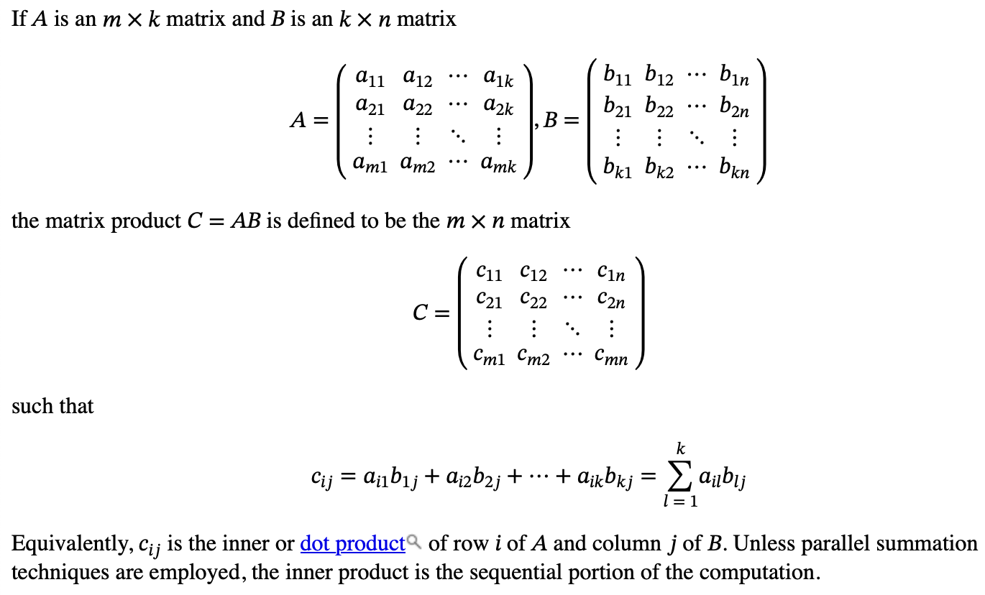
Notation
Primary purpose here is to introduce the BLAS M, N, K convention
and show MM as $mn$ inner products

Slide 3
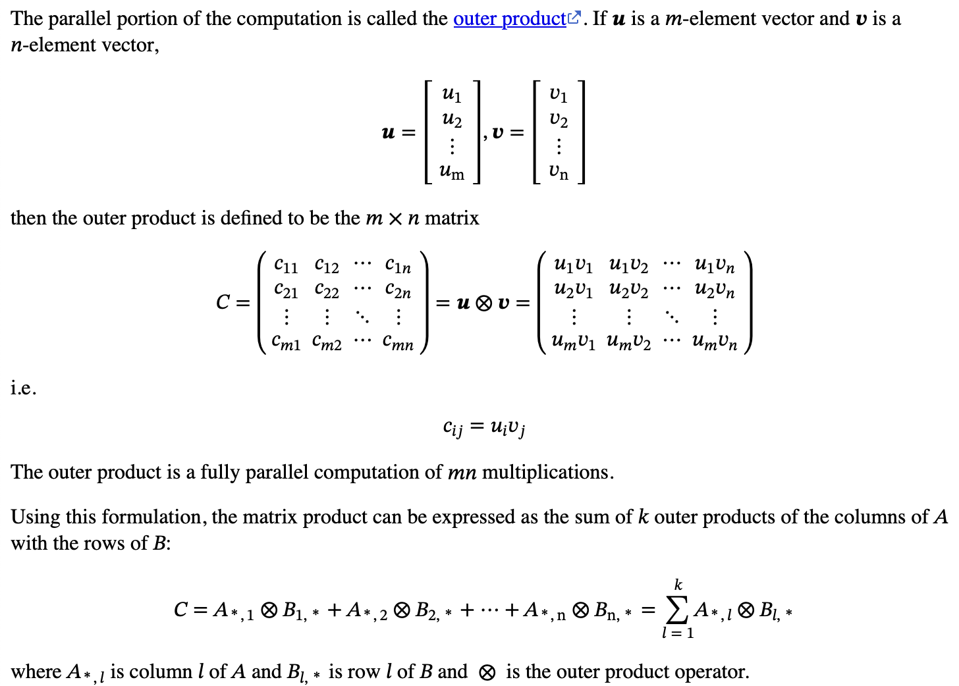
Notation (continued)
Key point is that MM can be seen as a sum of outer products

Slide 4
 |  |  |  |  |  |  |  |  |  |  |  |  |  |  |  |  |  |  |  |  |  |  |  |  |  |  | N |  |  | $$j$$
 | $C_{i,j}$ is the inner product of row $i$ of A and column $j$of B:
 |  | $$C_{i,j}=\sum_{l=1}^{K}{A_{i,l}B_{l,j}}$$ | $$C_{i,j}=\sum_{l=1}^{K}{A_{i,l}B_{l,j}}$$
 |  |  |  |  |  |  |  |  |  |  |  |  |  |  |  |  |  |  |  |  | K
 | Each $C_{i,j}$ can be computed in parallel. The sums to do so are generally sequential.
 |  |  |  |  |  |  |  |  |  |  |  |  |  | K |  |  |  |  |  |  |  |  |  |  |  |  |  |  |  | $$j$$
 |  |  |  |  |  |  |  |  | $$i$$ |  |  |  |  |  |  |  |  |  |  |  | $$i$$
 |  |  |  |  |  |  |  |  | M |  |  |  |  |  |  |  |  |  |  |  | M
 |  |  |  |  |  |  |  |  |  |  |  |  |  |  |  |  |  |  |  |  |  |  |  |  |  |  |  | N

Slide 5
 |  |  |  |  |  |  |  |  |  |  |  |  |  |  |  |  |  |  |  |  |  |  |  |  |  | N
$C$ is the sum of the outer products of column $l$ of A and row $l$of B:
 |  | $$C=\sum_{l=1}^{K}{A_{∗,l}{⊗B}_{l,∗}}$$
 |  |  |  |  |  |  |  |  |  |  |  |  |  |  |  |  |  |  |  | K
 |  |  |  |  |  |  |  |  |  |  |  |  | K
 |  |  |  |  |  |  |  | M |  |  |  |  |  |  |  |  |  |  |  | M
 |  |  |  |  |  |  |  |  |  |  |  |  |  |  |  |  |  |  |  |  |  |  |  |  |  |  | N

Slide 6
The Stationary Concept
The schoolbook MM method
for i ← 0 to m-1 for j ← 0 to n-1 for l ← 0 to k-1 c[i,j] ← c[i,j] + a[i,l] * b[l,j]
The i,j,l loops can be done in six different orders
Each ordering has different characteristics
The outer two loops determine which of A, B, or C is “stationary”: i.e., indexes unchanging in the inner loop
The schoolbook method makes C stationary
c[i,j] held in register, so load from A, load from B, MAC
Loads and stores of c[i,j] are in j loop, not the inner loop
Order l,j,i makes B stationary
b[l,j] held in register, so load from C, load from A, MAC, store C

Slide 7
C Usually Made Stationary
If A or B is stationary, references to C require load and store rather than just load
For AI data types C is often wider than A and B
e.g., FP8 A, FP8 B, FP32 C means 4 bytes to load, 4 bytes to store for C vs. 1 byte loads for A and B—an 8:1 ratio

Slide 8
RISC-V Matrix Extension TGs
RISC-V Vector (RVV) provides $2V$ OPs/cycle (i.e. $V$ MACs/cycle)
$V$ is load bandwidth in elements per cycle
Performs Matrix Multiply at this rate
RISC-V has two Task Groups (TGs)
IME for instruction additions to RVV, but no new state
Proposals are 5-8× performance of RVV
Not particularly energy efficient
AME is open ended, targeted at higher performance
e.g., targeting ≥64× RVV performance (i.e., >8× IME performance)
Energy efficiency should be another goal
Both target both AI and High-Performance Computing (HPC)
However, AI is more demanding in several ways (to be shown later)

Slide 9
Context
Matrix multiplication is used in many areas
Some are small matrixes of wide numbers
Example: 3×3 for coordinate transform using FP32 or FP64
However, AI uses large matrixes, too big to fit on-chip
Data is narrow (e.g., 16, 8, 6, or 4 bits)
Much of progress in AI is going to narrower and narrower data types
More exponent bits, less precision appears most useful for AI
Issue: FP add latency (denoted Δ) typically 4, compared to 1 for integer
Issue: how to stream the matrix data from off-chip to the computation in an efficient way
Pressure for narrow data types comes from need to make streaming more efficient
Narrow data types are “widened” during computation
GPUs typically do FP32 ← FP32 + FP8 × FP8 (4× widening)
i.e. FP32 accumulation, but is this necessary (convenient for GPUs but…)?
Creates VLSI layout issues, only 2× widening supported by RVV

Slide 10
A Few AI Data Types
Size | Name | Sign | Exponent | Precision | Comment
32 | FP32 | 1 | 8 | 1+23 | Single Precision
 | TF32 | 1 | 8 | 1+10 | Nvidia 4-element dot product
16 | FP16 | 1 | 5 | 1+10 | 2008 IEEE format for graphics
 | BF16 | 1 | 8 | 1+7 | Google Brain Float ~2017
8 | E5M2 | 1 | 5 | 1+2 | Open Compute Project
 | E4M3 | 1 | 4 | 1+3 | Open Compute Project
 | E8M0 | 0 | 8 | 0 | Open Compute Project
 | E0M7 | 1 | 0 | 7 | 8-bit integer Sb.bbbbbbb (int8)
6 | E3M2 | 1 | 3 | 1+2 | Open Compute Project
 | E2M3 | 1 | 2 | 1+3 | Open Compute Project
4 | E2M1 | 1 | 2 | 1+1 | Open Compute Project
 | E0M3 | 1 | 0 | 3 | 4-bit integer Sb.bbb (int4)
Other non-standard data types exist, e.g., k-quants

Slide 11
AI Activations and Weights
Biological neurons
Take inputs via their dendrites with synaptic connections to axons terminals
Weight inputs and sum
Fire when the sum exceeds a certain value
Transmit the firing down the axon to synapses of next layer
A brain consists of many neurons, sometimes grouped into layers
Artificial neurons
Take a vector of inputs (the activations)
Perform a dot product of the inputs with weights
Apply an activation function (e.g., ReLU) to the dot product
Send the result (the activation) to the next layer of the model
The columns of B might represent the synaptic weights of the inputs
Tokens are represented as vectors, stored in rows of the A matrix
Heads are an extra mechanism for “attention” within a layer

Slide 12
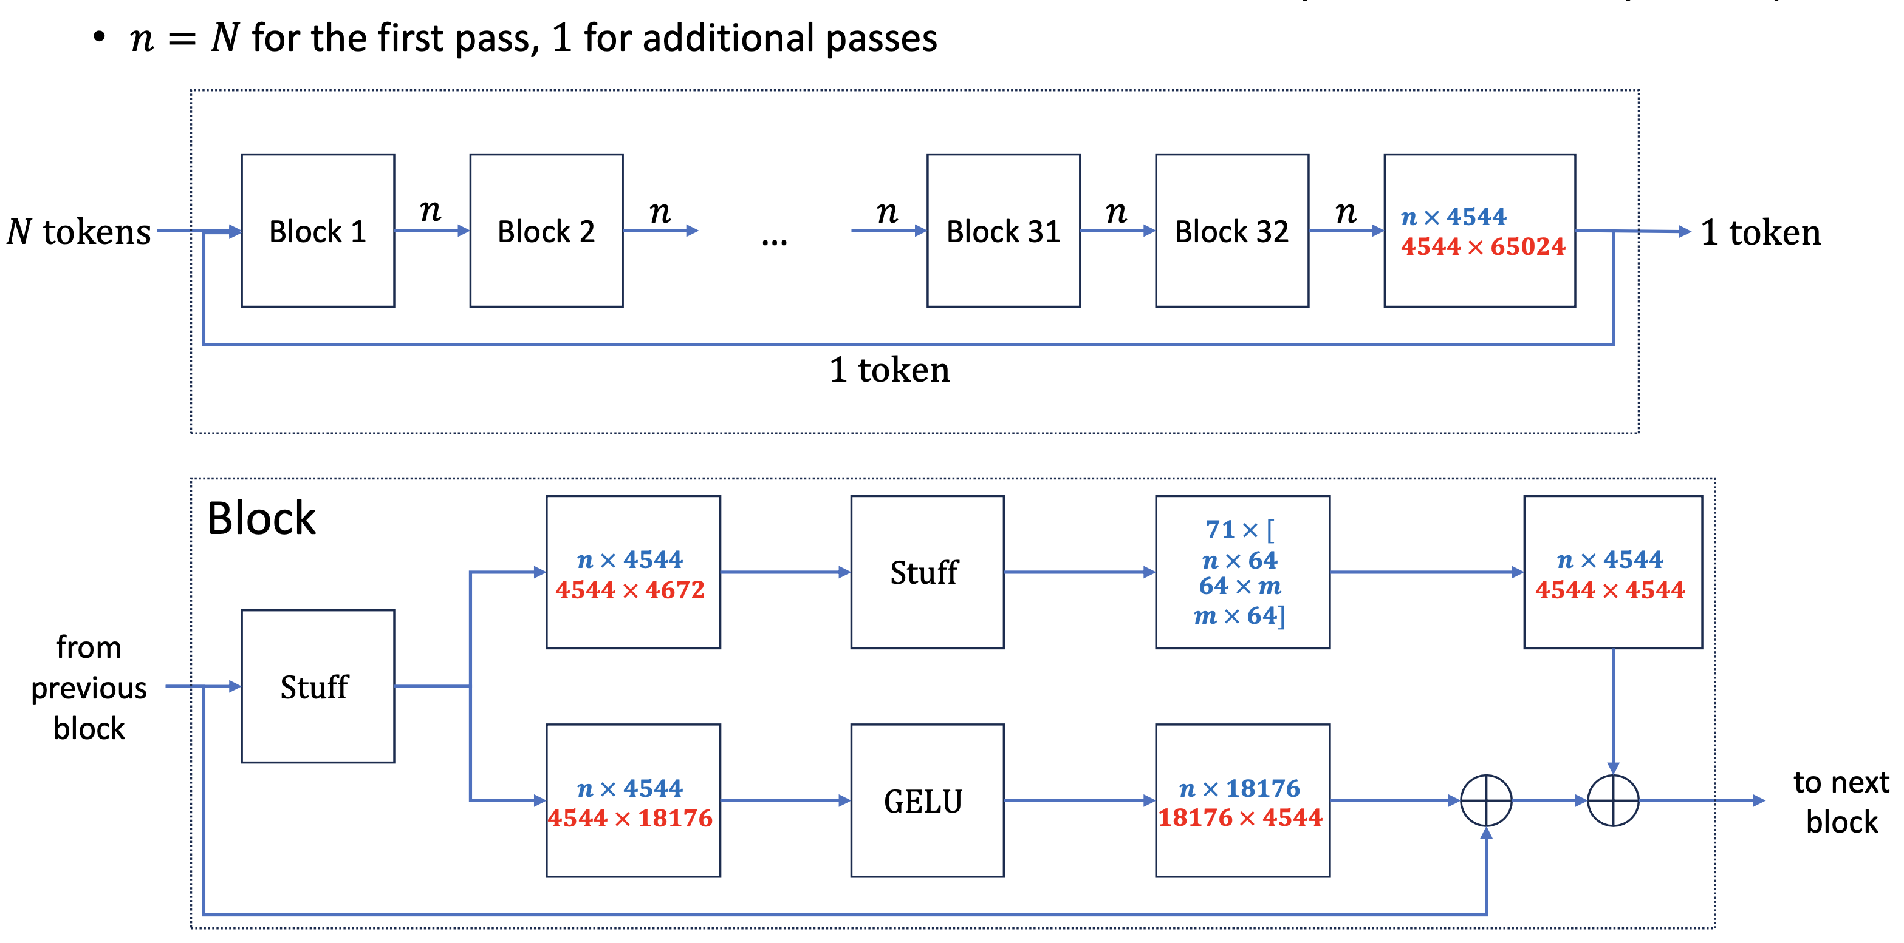
Falcon 7B LLM (Hugging Face)

Slide 13
Operation to Memory Ratios
Level 1 BLAS: O($N$) data, O($N$) ops, O(1) ops to data ratio
2:3 axpy y[i] += alpha*x[i]
1:2 scal x[i] *= alpha
1:1 dot s += x[i]*y[i]
Level 2 BLAS: O($N^{2})$ data, O($N^{2})$ ops, O(1) ops to data ratio
2:1 gemv y[i] = beta*y[i] + alpha*A[i,j]*x[j]
Level 3 BLAS: O($N^{2}$) data, O($N^{3}$) ops, O($N$) ops to data ratio
N:1 gemm C[i,j] = beta*C[i,j] + alpha*A[i,k]*B[k,j]
Other
M×M Convolution (e.g., 3×3 or 5×5, stride 1 or stride M)
1D FFT O$(N\log{N}$), 2D FFT O($N^{2}\log{N}$)
Motion search O($N^{2}$) data, O($N^{3}$) ops, O($N$) ops to data ratio
Other matrix: mostly O($N^{2}$) data, O($N^{2}$) ops, O(1) ops to data ratio
1:3 Addition A[i,j] = B[i,j] + C[i,j]
1:2 Scale A[i,j] = alpha*B[i,j]

Slide 14
Vector vs. Matrix
Vector ISAs provide O(1) ops:data ratio
Most vector implementations provide 2:1 ops to load/store
Matched to Level 1 and Level 2 BLAS and many matrix operations (e.g., addition, scaling)
Matrix can outperform Vector by using more MAC units
Only useful for algorithms with high op to load/store ratios
More MACs irrelevant for gemv—time spent waiting for memory
For algorithms that benefit, each value loaded is used many times
Target Level 3 BLAS, e.g., matrix multiply
Matrix operations for algorithms without high ratios are not useful

Slide 15
Matrix Multiply Implementation
Matrix multiply is O($N^{3})$ operations on O($N^{2})$ data
Much more computation than data
Each element used in N computations
Engineering concern is how to get as much use of a matrix element once it is read from memory
maximizing how the number of times it is used
minimizing the number of times it is reloaded
Best would be having O($N^{2})$ on-chip storage
One load per element
Use each load N times
Not practical for tens of MB

Slide 16
Solution: Matrix multiply by tiles
The same equations and loops apply when $C_{ij}$, $A_{il}$, and $B_{lj}$are scalars or matrixes
For example, pick a $s×t$ C tile which is the sum of products of $s×r$ tiles of A with $r×t$ tiles of B
If $s×r$ and $r×t$ tiles are sized to fit in L2 and/or LLC, the data is used multiple times, reducing references to DRAM
 |  |  |  |  | n |  |  |  |  |  |  |  |  |  |  | k |  |  |  |  |  |  |  |  | 𝑗 |  | n
m |  |  |  |  |  |  |  |  |  | = | m |  |  |  |  |  |  |  |  |  | × | k |  |  | t
 |  |  | t |  |  |  |  |  |  |  |  |  |  |  |  |  | r |  |  |  |  |  |  | r | 𝑙,𝑗 |  |  |  |  |  |  | 𝑙
 |  | s | 𝑖,𝑗 |  |  |  |  |  |  |  | 𝑖 |  |  |  |  | s | 𝑖,𝑙
 |  |  |  |  |  |  |  |  |  |  |  |  |  |  |  |  | 𝑙

Slide 17
Wide vs. Narrow (Fat vs. Skinny) vs. Full
When doing MM by tiles, the common dimension of A and B (typically denoted K) is of great import
K=1 means that A is M×1 and B is 1×N, i.e. vectors i.e., C tile is the outer product of vectors of A and B
K=2 or K=4: C tile is sum of K outer products, i.e., each $C_{ij}$ is a K-element inner product (a “narrow” or ”skinny” inner product MM)
For larger K (e.g., ≥8) this might be called a “wide” or “fat” inner product MM
When K of similar magnitude to M,N: call this a Full MM
Whether to target OP, Narrow MM, Wide MM, or Full MM is a critical question

Slide 18
Using Memory Data Multiple Times
An C tile of $T×T$ OP uses each source element $T$ times (reducing references to DRAM from $N$ to $N/T$ )
Energy efficiency therefore wants to maximize $T$ (fewer reloads)
Maximizing $T$ with full MM means $\left(w+2\right)T^{2}$register file storage (C, A, B), where C is $w$ times wider than A and B
Maximizing $T$ with outer product (OP) means ${O(T}^{2})$ for C only A and B are only $T$-element vectors
For the same number of register file bits, outer product supports larger $T$
Widening the OP with K>1 does not increase load reuse and does not improve energy efficiency

Slide 19
Matrix Multiply Tiling Example
MM (C += AB) has parallel and sequential aspects
The O($N^{2}$) outer product of two N-element vectors is the parallel portion
Summation of outer products O($N$) is the sequential portion
Only the C tile requires matrix storage — vectors from A and B sufficient
MM is easily done via C, A, and B tiles that fit in smaller memories
C tile for accumulator array (e.g., 64×64—16 KiB)
A, B tiles for L2 (e.g., each 512×512—256 KiB—blocks read 8 times, used 64)
Tile for Last Level Cache (e.g., each 2048×2048—4 MiB—blocks read 4 times)
Software like BLIS exploits tiling and packs data for unit stride access
C tiles can be computed in parallel by MP, sharing A and B tiles in LLC
Use non-temporal hints on C tiles to avoid caching and displacing A and B tiles

Slide 20
Some Matrix Multiply Configurations
Main Memory
Main Memory
Main Memory
L3 cache
Shared LLC
L2 cache
L2 cache
L2 cache
L2 cache
L2 cache
L2 cache
Vector
Matrix
Vector
Matrix
Vector
Matrix
Vector
Matrix
Vector
Matrix
Vector
Matrix
Processor
Processor
Processor
Processor
Processor
Processor

Slide 21
Sharing A and B Tiles in Last Level Cache (LLC)
 |  |  | j | j+1 | N |  |  |  |  |  |  |  |  |  | K
 |  |  |  |  |  |  |  |  |  |  |  |  |  |  |  |  |  |  |  |  |  |  | j | j+1 | N
M |  |  |  |  |  |  |  |  |  | = | M |  |  |  |  |  |  |  | × | K
i |  |  |  |  |  |  |  |  |  |  | i
i+1 |  |  |  |  |  |  |  |  |  |  | i+1
 |  |  |  |  | C |  |  |  |  |  |  |  |  |  | A |  |  |  |  |  |  |  |  |  | B
Each A tile used for two C tiles. Each B tile used for two C tiles.
Gradient used to indicate prefetch of next tiles into LLC
“Packing” may be used when copying A and B tiles to LLC

Slide 22
Balanced Load/Compute for Load bandwidth V
 | Outer Product |  | Full Matrix Multiply
 | $$Δ≤2$$ | $$Δ=4$$ | $$Δ=1$$ | $$Δ=4$$
Load A (elements) | $$V$$ | $$2V$$ | $$V×V$$ | $$2V×2V$$
Load B (elements) | $$V$$ | $$2V$$ | $$V×V$$ | $$2V×2V$$
Load to | VRF | VRF | MRF | MRF
Load cycles | 2 | 4 | $$2V$$ | $$8V$$
MAC array | $$V×(\frac{V}{2})$$ | $$V×V$$ | $$V×(\frac{V}{2})$$ | $$V×V$$
Compute cycles | 2 | 4 | $$2V$$ | $$8V$$
C tile ($w$ wider) | $$V×V$$ | $$2V×2V$$ | $$V×V$$ | 2$V×2V$
C tile location | 1 per MAC | 4 per MAC | MRF | MRF
Ops | $${2V}^{2}$$ | $$2{\left(2V\right)}^{2}$$ | $$2V^{3}$$ | $$2{\left(2V\right)}^{3}$$
Ops / cycle | $$\frac{2V^{2}}{2}=V^{2}$$ | $$\frac{8V^{2}}{4}=2V^{2}$$ | $$\frac{2V^{3}}{2V}=V^{2}$$ | $$\frac{16V^{3}}{8V}=2V^{2}$$
Intensity 𝜂 | $$\frac{2V^{2}}{2V}=V$$ | $$\frac{8V^{2}}{4V}=2V$$ | $$\frac{2V^{3}}{2V^{2}}=V$$ | $$\frac{16V^{3}}{8V^{2}}=2V$$
Storage | $$2V+wV^{2}$$ | $$4V+4wV^{2}$$ | $$2V^{2}+wV^{2}$$ | $$8V^{2}+4wV^{2}$$
Full MM same performance and intensity as OP, more storage, iteration in hardware vs. software

Slide 23
Conclusion: OP vs. Full MM
OP is uniformly superior to Full MM
Same performance, intensity, less storage, iteration in software rather than hardware
C tile is only ${wV}^{2}$ storage, general MRF not required
C tile location belongs in the MAC units
C file in VRF is far from compute, high-power, high-area
VRF bits have minimum 4 read ports, 2 write ports
VRF size increase required to hold ${wV}^{2}$ C tile—not a good trade-off
Distributed accumulators in the MAC array are local, low-power, low-area
Local accumulator bits have 1 read, 1 write port

Slide 24
Balanced Load/Compute for Load bandwidth V
 | Outer Product |  | Skinny Matrix Multiply ($k$-inner)
 | $$Δ≤2$$ | $$Δ=4$$ | $Δ_{inner}=1$, $Δ_{outer}≤8$
Load A (elements) | $$V$$ | $$2V$$ | $$kV$$
Load B (elements) | $$V$$ | $$2V$$ | $$kV$$
Load to | VRF | VRF | VRF
Load cycles | 2 | 4 | $$2k$$
MAC array | $$V×(\frac{V}{2})$$ | $$V×V$$ | $$\left(\frac{V}{2}\right)×\left(\frac{V}{k}\right)×k$$
Compute cycles | 2 | 4 | $$2k$$
C tile ($w$ wider) | $$V×V$$ | $$2V×2V$$ | $$V×V$$
C tile location | 1 per MAC | 4 per MAC | 2k per MAC
Ops | $${2V}^{2}$$ | $$2{\left(2V\right)}^{2}$$ | $${2kV}^{2}$$
Ops / cycle | $$\frac{2V^{2}}{2}=V^{2}$$ | $$\frac{8V^{2}}{4}=2V^{2}$$ | $$\frac{2kV^{2}}{2k}=V^{2}$$
Intensity 𝜂 | $$\frac{2V^{2}}{2V}=V$$ | $$\frac{8V^{2}}{4V}=2V$$ | $$\frac{2kV^{2}}{2kV}=V$$
Storage | $$2V+wV^{2}$$ | $$4V+4wV^{2}$$ | $$2kV+wV^{2}$$

Slide 25
Opservations: OP vs. Skinny MM (OP+small inner)
Minimum tile size is the same for both ($T=V$) for $Δ≤2$
Tile size determines performance, $k$ has no effect
Tile size determines load reuse (energy efficiency), $k$ has no effect
Generally increasing $T$ (e.g., $2V$) is better than increasing $k$

Slide 26
Conclusion: OP vs. Skinny MM (OP+small inner)
For $Δ≤2$: Same performance, intensity, storage, OP simpler (2 vs. 8 cycle), no inner-product hardware
For$,Δ>2$: OP pushed to $2V×2V$ C tile to use pipelined MACs:
2× performance, 2× intensity, 2× data reuse/efficiency, 2× logic area, 4× storage
Often a good trade-off, but not always
Skinny MM with $Δ_{inner}=1$is not as $Δ_{outer}$ sensitive, so can match load bandwidth at $T=V$ and thus lower performance
Requires special inner-product hardware
Benefits from $2k$ VRF read ports (workaround exists—adds complexity)
Requires operand storage in MACs to save power on operand delivery
Potentially higher $Δ_{outer}$ requiring extra pipeline stages and power
Can match $2V×2V$ performance by going to $4k$ cycles
Whether OP or Skinny MM better for $Δ>2$ depends on performance/cost goals—RISC-V should not force choice

Slide 27
Inner Product
Integer addition is commutative and associative: ((A+B)+C)+D = (A+B)+(C+D)
Floating-point addition is not associative: (A+B)+C ≠ A+(B+C) due to rounding
Carry-Save Adders (CSAs) can reduce N integer sums to two in log time
Sum of 3 bits has values 0-3, so fits in 2 bits
Tree of 3-to-2 CSAs reduces many sums to just 2
Final carry-propagate add sums the 2 values
FP “bulk normalization” lets FP use CSA trees, but a different rounding results
Issue: does floating-point matrix multiply need to get the same rounding as schoolbook algorithm?
Integer not an issue, but FP is preferred data format

Slide 28
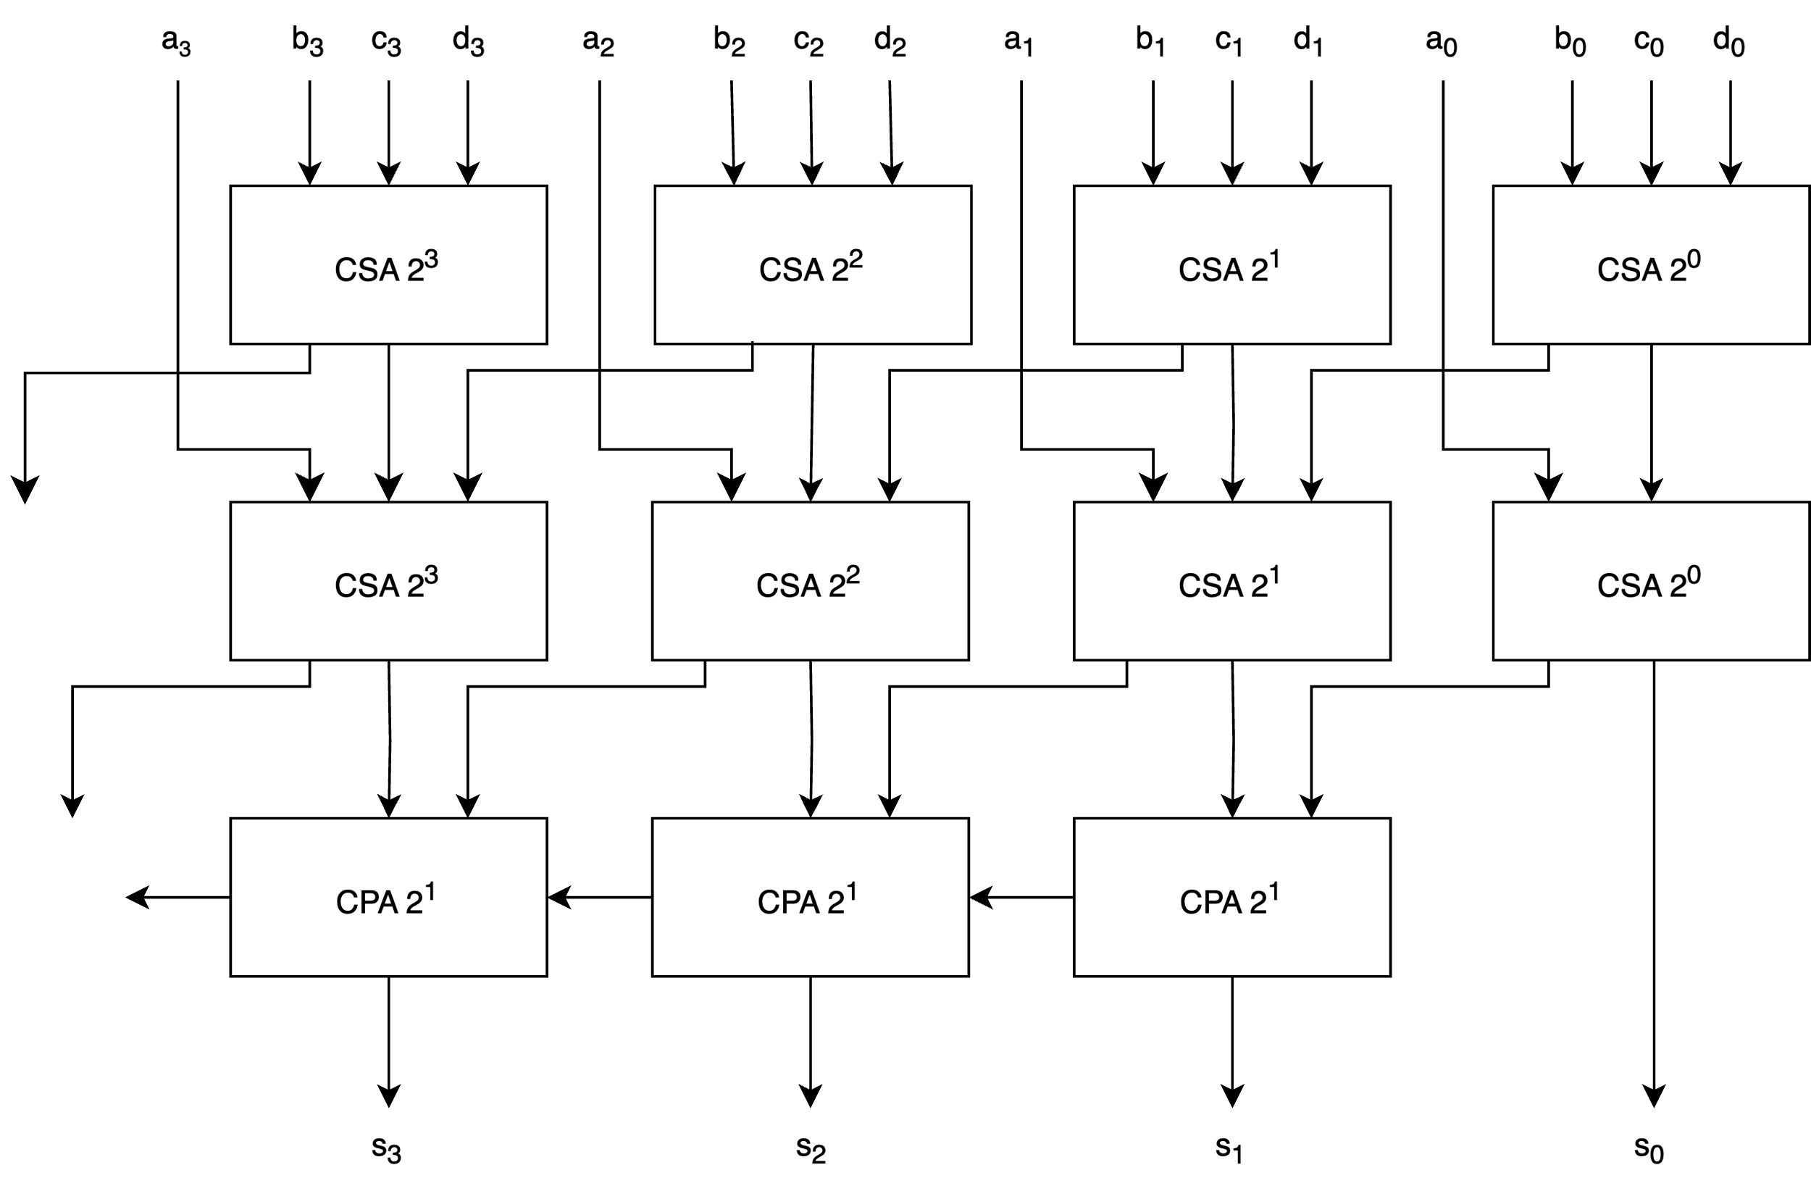
Carry-Save Adder (CSA) Tree

Slide 29
Why Inner Product Keeps Returning
Outer product has many nice properties
$T^{2}$ performance makes it easy to target a wide range
Using inner products adds no performance
But engineers sometimes augment OP with inner product
One reason is widening
Small data types are multiplied, and accumulated in higher precision, e.g., FP32 ← FP32 + FP8×FP8 ($w=4$)
RVV not well-suited for >2× widening
e.g., proposal to add fat inner product to RVV reduces accumulation tile size to support widening
FP32 adders naturally lay out in datapaths wider than FP8 multipliers
Tempting to put 2-4 FP8 multipliers in the width of one FP32
Another reason is handling $Δ>2$ when $T=2V$ is too big

Slide 30
Example Tile Sizes
C tile bits 𝑏 for efficient parallel computation for MLEN and SEW
SEW MLEN | Δ=1 |  | Δ=4
 | int4 | int8 | FP4 | FP8 | FP16 | FP32 | FP64
 | $$w=8$$ | $$w=4$$ | $$w=8$$ | $$w=4$$ | $$w=2$$ | $$w=1$$
128 | 32768 | 8192 | 131072 | 32768 | 8192 | 2048 | 1024
256 | 131072 | 32768 | 524288 | 131072 | 32768 | 8192 | 4096
512 | 524288 | 131072 | 2097152 | 524288 | 131072 | 32768 | 16384
1024 | 2097152 | 524288 | 8388608 | 2097152 | 524288 | 131072 | 65536
Note: small data types are much easier compute but require much greater tile storage due to O($N^{2}$) elements computed with wide accumulation!
Note: pure FP4 and FP6 E2M3 can be done in integer (Δ=1, ¼ of $b$ above) if not mixed format. Note further: mixed format for AI may become common. Conclusion: AI trend towards small data types demands efficient C tile bits.

Slide 31
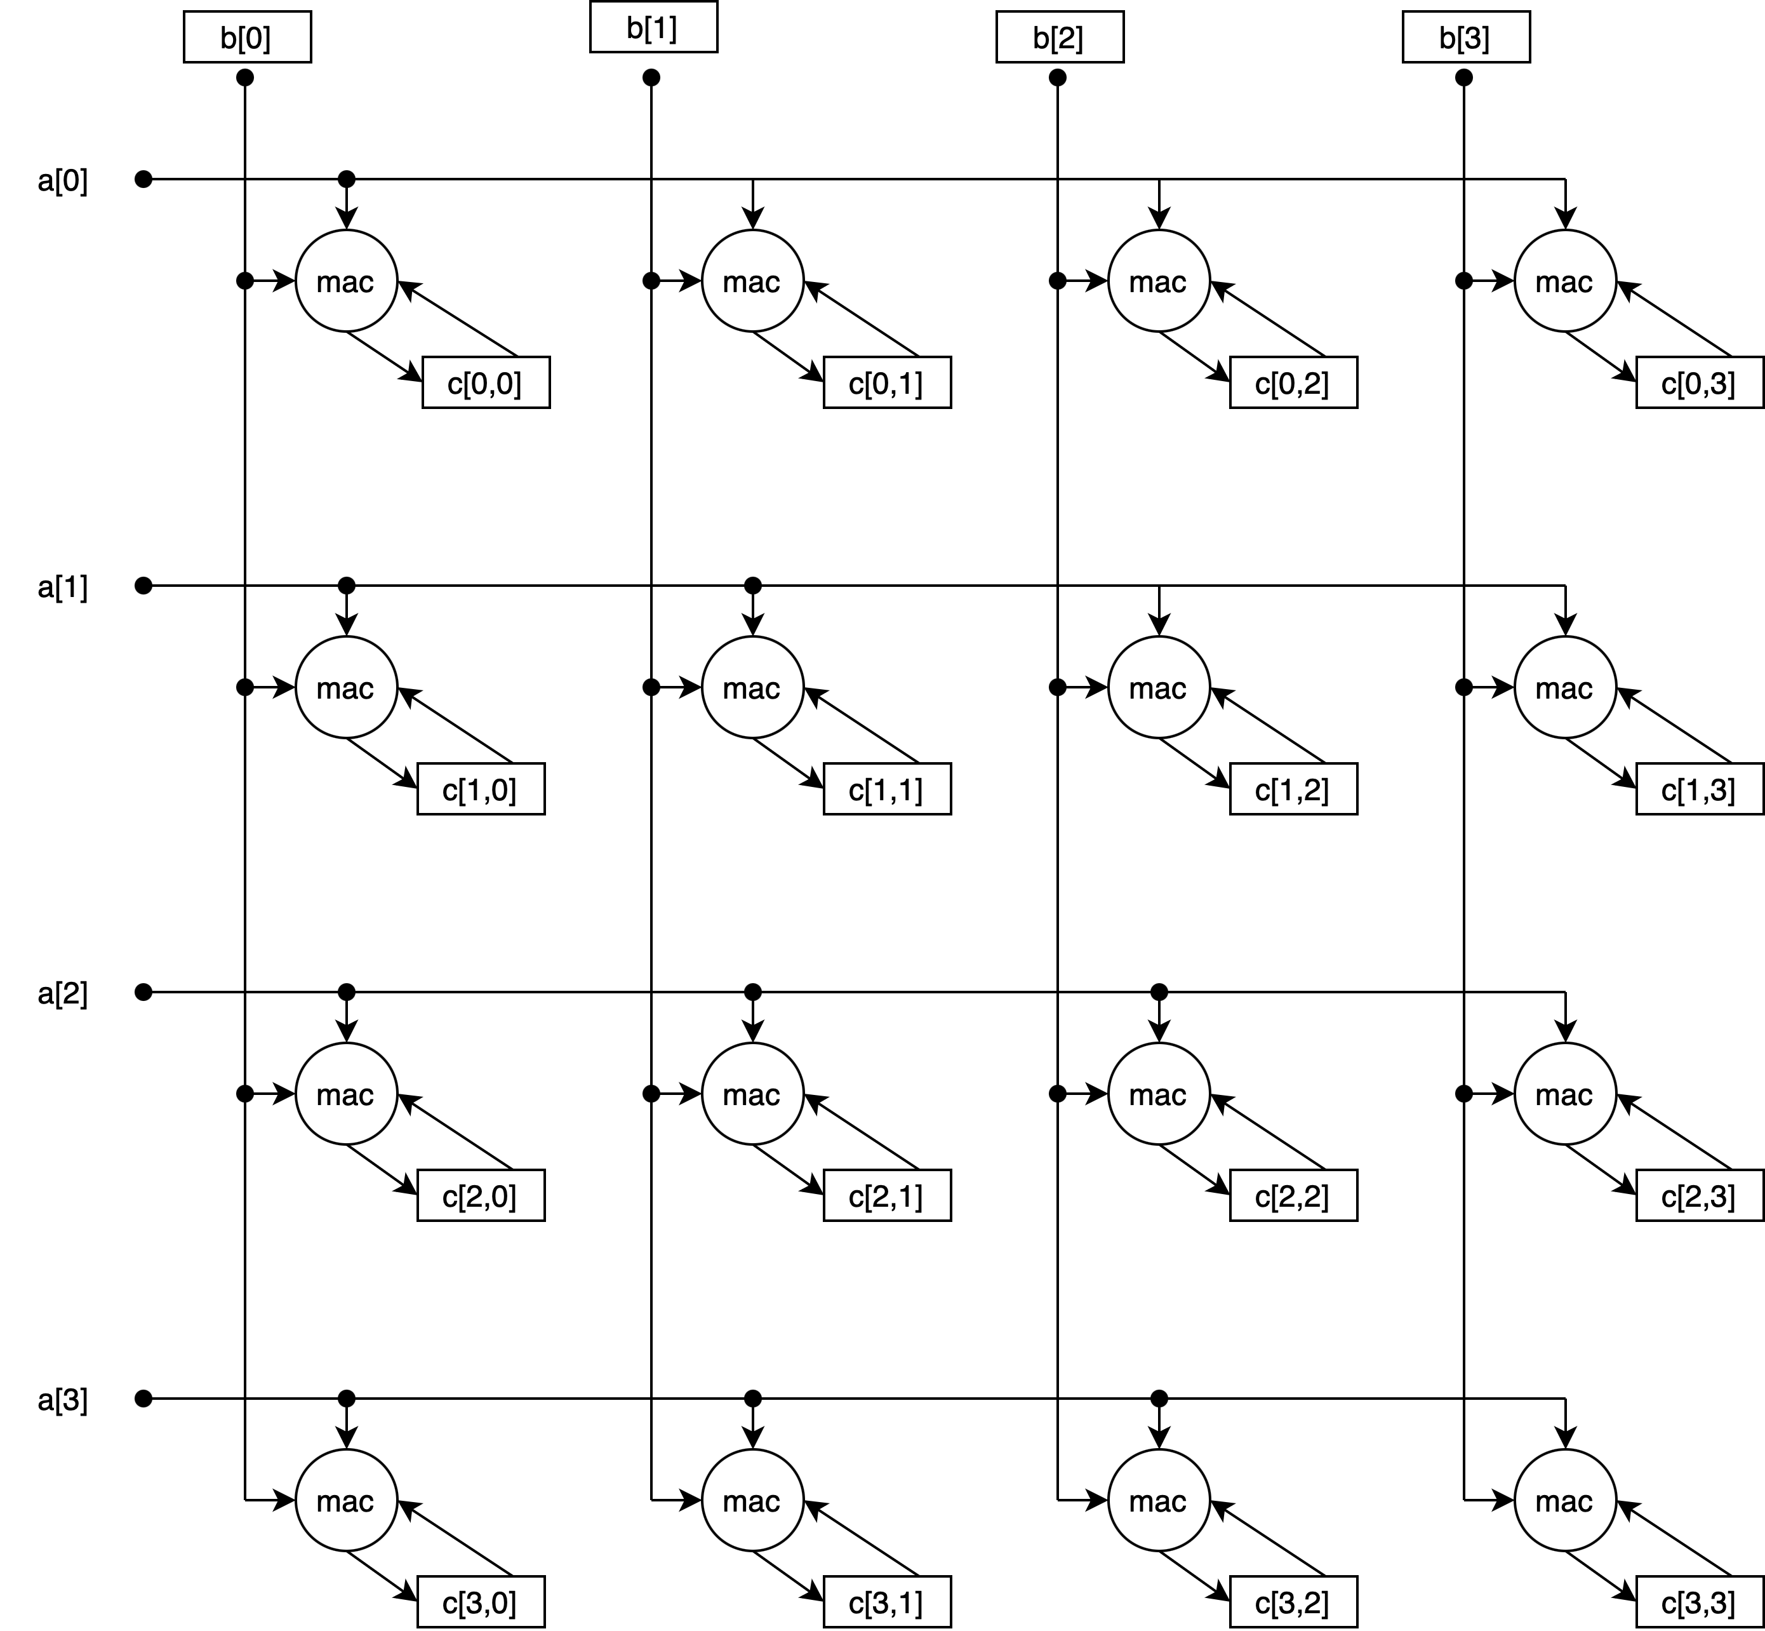
A 4×4 Outer Product Accumulator Array

Slide 32
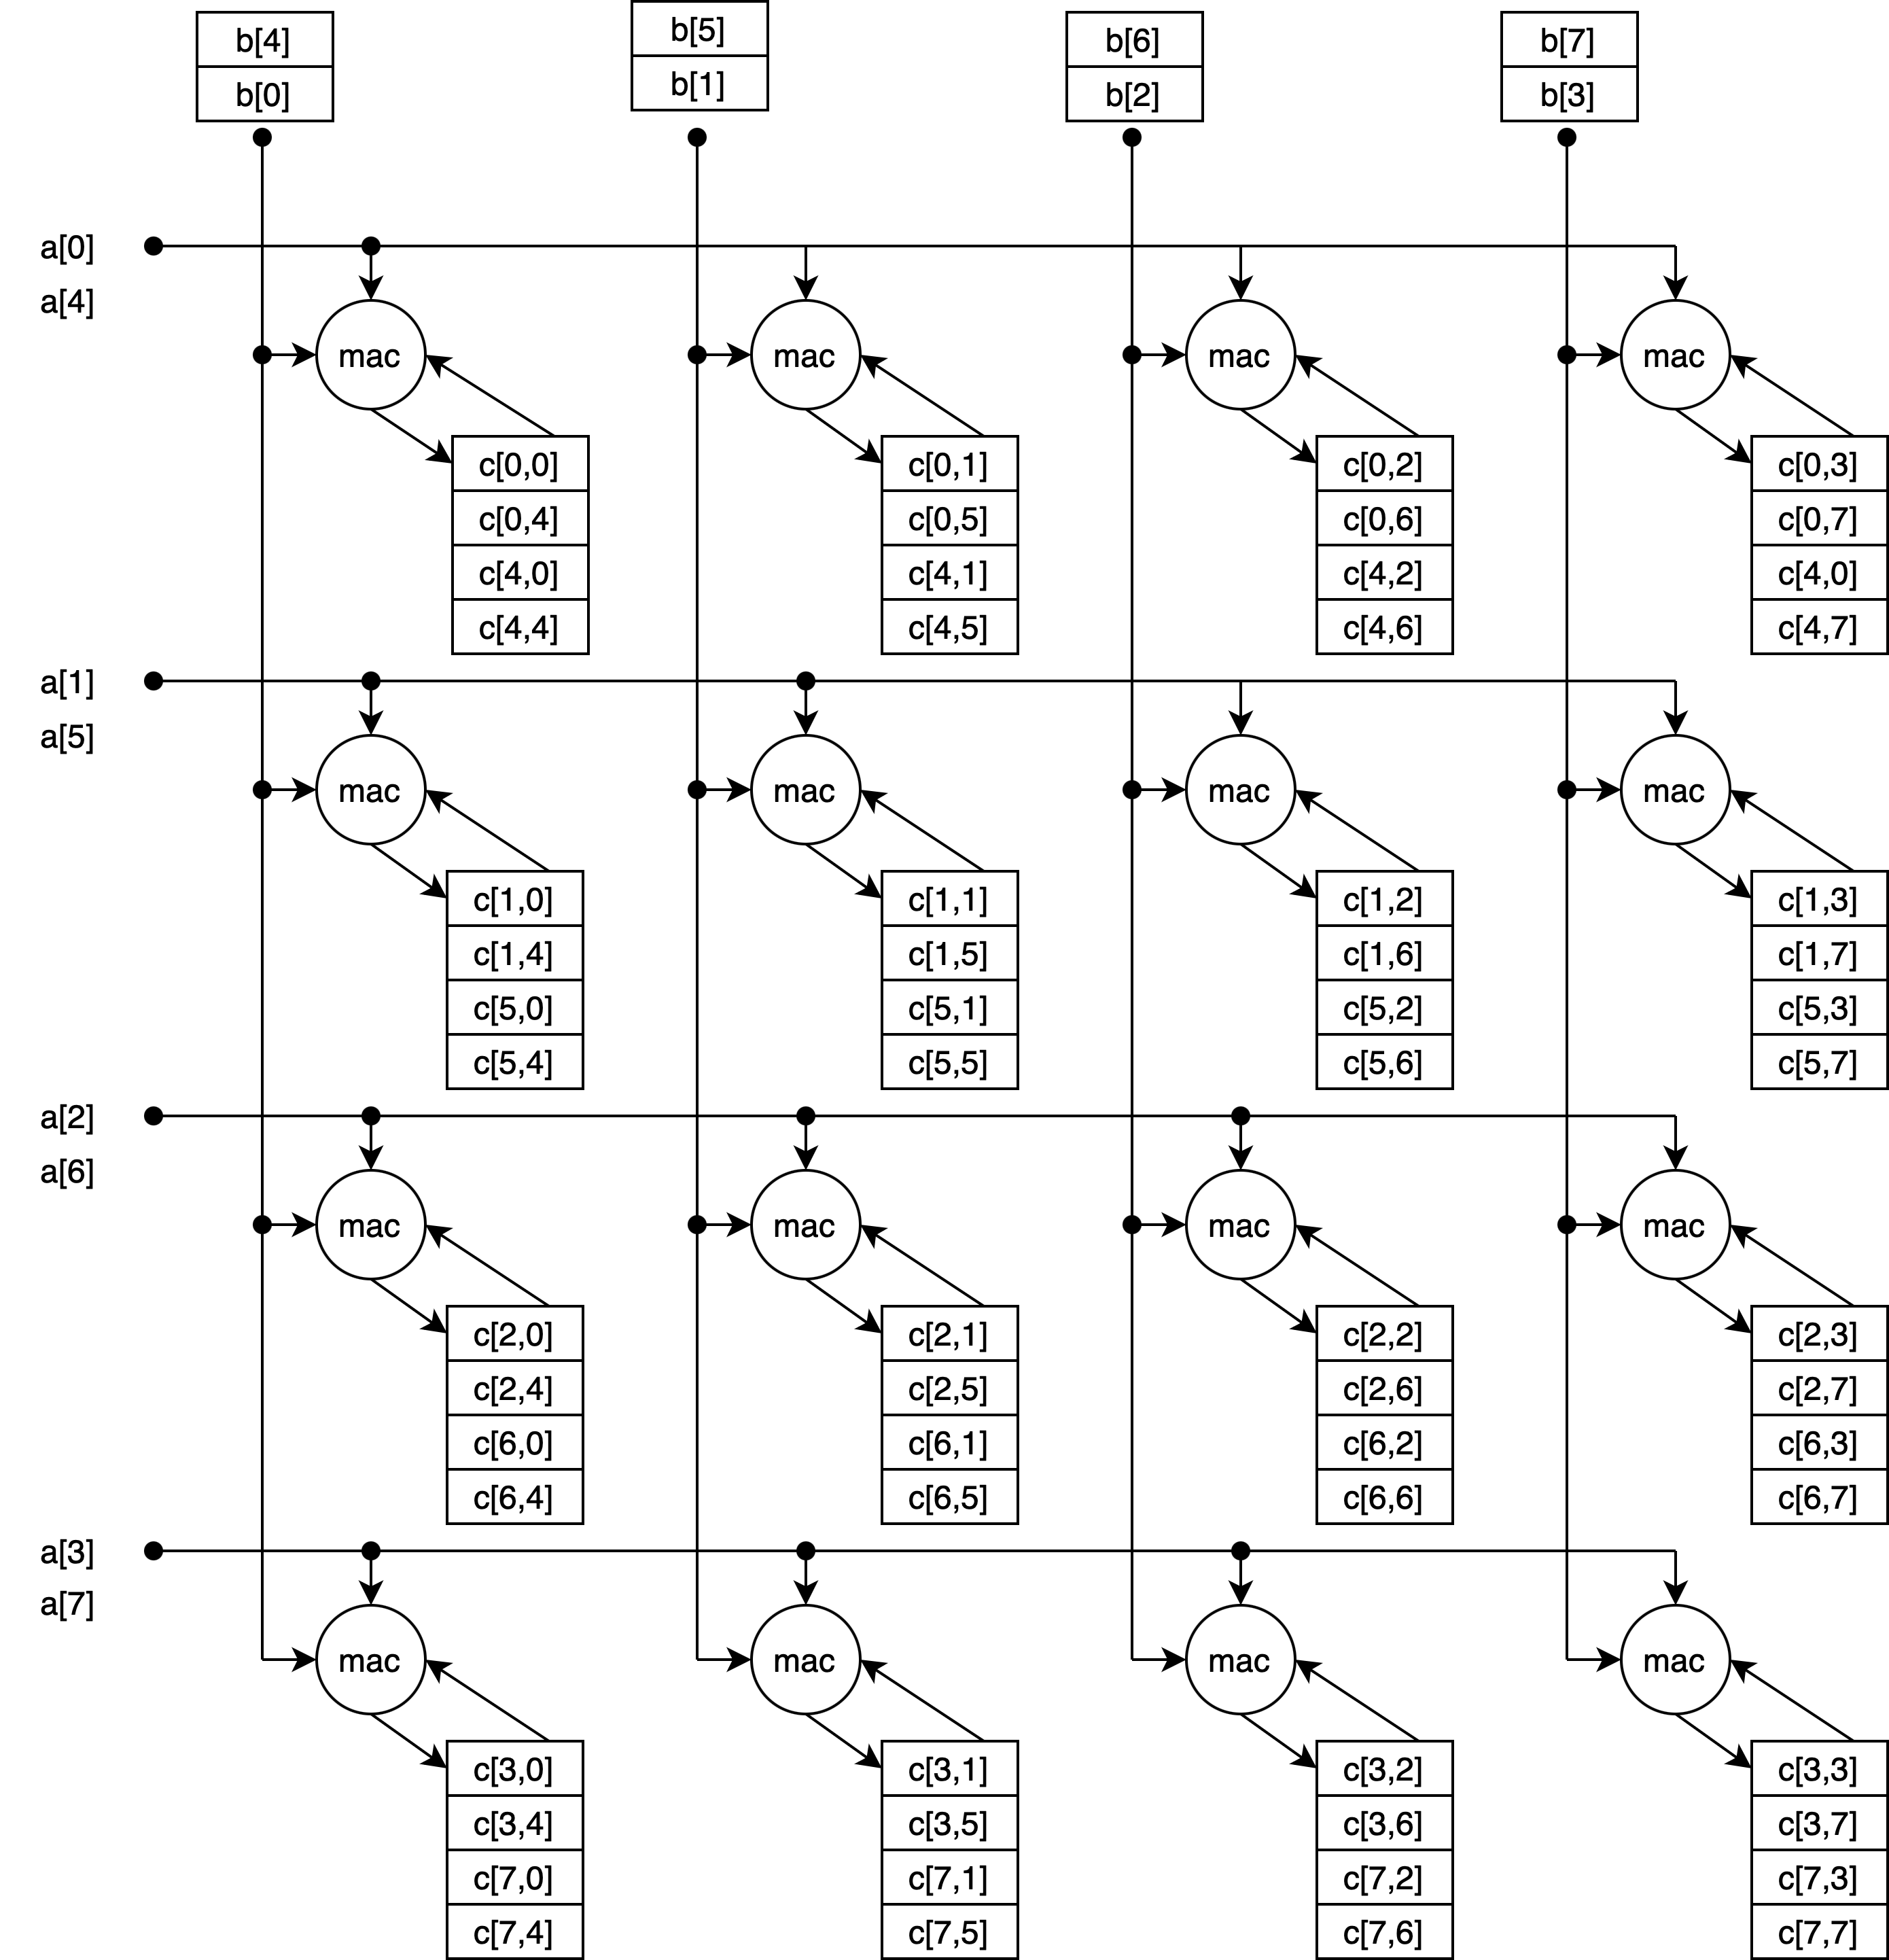
A 4×4 Outer Product MAC Array with 4 Accumulators per MAC

Slide 33
VLSI Layout
VLSI works best when regular structures used
Minimizes problems in routing wires, minimizes area/delay
 |  |  |  | 63 |  |  |  |  |  |  |  |  | 0
 |  | Decode |  | Register File
 |  |  |  |  |  |  |  |  |  |  |  |  |  |  |  |  | Examples: Integer and Floating-Point Units
 |  |  |  | 63 |  |  |  |  |  |  |  |  | 0
 |  | Control |  | Datapath
 |  |  |  |  |  |  |  |  |  |  |  |  |  |  |  |  | Register files characterized by bit width number of entries number of read ports number of write ports

Slide 34
Vector Layout
 |  |  | 63 |  |  | 0
 | Decode |  | RF |  |  |  |  | Buffer |  | RF |  |  |  |  |  |  | RF |  |  |  |  |  |  | RF
 |  |  | Cross-datapath communication
 | Control |  | Datapath |  |  |  |  | Buffer |  | Datapath |  |  |  |  |  |  | Datapath |  |  |  |  |  |  | Datapath

Slide 35
Outer Product Layout
 |  |  | Vector Register File
 |  |  |  |  |  |  |  |  |  |  |  |  |  |  |  |  |  |  |  |  |  |  |  |  |  |  | A vector vertical B vector horizontal Very long wires
 |  |  | Vector Datapath
 |  |  |  |  |  |  |  |  | ⋯
 |  |  |  |  |  |  |  |  | ⋯
 |  |  |  |  |  |  |  |  | ⋯
 |  |  |  |  |  |  |  |  | ⋯
 |  |  | ⋮ |  |  | ⋮ |  |  | ⋮ |  |  | ⋮ |  |  | ⋮ |  |  | ⋮ |  |  | ⋮ |  |  | ⋮
 |  |  |  |  |  |  |  |  | ⋯

Slide 36
IME Fat-Inner (FIP) vs. RVV+OP for SEW=8 EEW=32
VRF |  |  | Fat Inner-product IME |  |  |  |  |  | RVV+OP
DLEN | VLEN | VRF bytes | m | k | n | loop cyc | OP /cyc | CI | acc | acc bytes | OP /cyc | CI | IME ratio | load reduce
256 | 256 | 1024 | 23 | 8 | 32 | 31 | 380 | 5.9 | 32×32 | 4096 | 1024 | 16 | 2.7× | 2.8×
256 | 512 | 2048 | 23 | 8 | 64 | 62 | 380 | 5.9 | 32×32 | 4096 | 1024 | 16 | 2.7× | 2.8×
256 | 512 | 2048 | 15 | 16 | 64 | 62 | 495 | 7.7 | 32×32 | 4096 | 1024 | 16 | 2.1× | 2.1×
512 | 512 | 2048 | 23 | 8 | 64 | 31 | 760 | 5.9 | 64×64 | 16384 | 4096 | 32 | 5.4× | 5.5×
512 | 512 | 2048 | 15 | 16 | 64 | 33 | 931 | 7.7 | 64×64 | 16384 | 4096 | 32 | 4.4× | 4.2×
512 | 1024 | 4096 | 23 | 8 | 128 | 62 | 760 | 5.9 | 64×64 | 16384 | 4096 | 32 | 5.4× | 5.5×
512 | 1024 | 4096 | 15 | 16 | 128 | 62 | 991 | 7.7 | 64×64 | 16384 | 4096 | 32 | 4.1× | 4.2×
512 | 1024 | 4096 |  |  |  |  |  |  | 128×128 | 65536 | 8192 | 64 | 8.2× | 8.4×
Significant performance and energy improvements

Slide 37
Comparison: RVV vs. IME Fat-Inner (FIP) vs. AME OP
Tradeoffs
 | Pros | Cons
RVV | Existing solution achieving DLEN/SEW MAC/cycle Well-defined rounding | Does not support quad-widening or octo-widening Scalability limited by 32 Vector Registers
RVV + FIP | Supports quad-widening and octo-widening More throughput than RVV for most configurations May extend to mixed-precision support No state addition to RVV Same register renaming requirements as RVV | Potentially different results from RVV and IME Optimal code sequence depends on VLEN Extra Vector Register File banking Scalability limited by 32 Vector Registers Format-specific sum reduction hardware Generally lower performance and more loads than OP VLEN ≤ 128 not supported
AME OP | Supports quad-widening and octo-widening Usually best throughput and energy efficiency Performance/efficiency quadratic in DLEN Accumulator bits less expensive than VRF bits Easily scalable up by increasing accumulators Easily scalable down by decreasing accumulators Possible to match compute to load bandwidth Potentially well-defined rounding VLEN ≤ 128 supported Efficient transpose | Accumulators are extra state, potentially large OoO processors either need to rename accumulators or perform outer product accumulation after commit

Slide 38
Earl’s Opinions

Slide 39
What’s IME and AME are Missing
IME and AME need to be running complete AI Applications, not doing MM spreadsheets
IME and AME don’t seem to have a focus on energy efficiency, which seems like a problem
IME and AME need to address memory layout issues, including transpose and inner-product packing
IME and AME are falling back on inner-product too readily to address widening and losing energy efficiency as a result

Slide 40
AME Should Build On RVV
RVA processors have RVV, need a high-end performance MM option
IME is good, but not great – need great against other ISAs
RVV processors have or often have
High-performance cache hierarchy useful for tiling
Multiprocessor support
RVV provides
Vector Load/Store for Outer Product
Vector Operations for O(1) ratio kernels
Framework for scalable ISA
RVV outer-product needs an accumulator tile

Slide 41
What Should Be In AME
Architectural state for accumulators
Instructions that accumulate the outer product of two vectors in an 2D tile local to the MAC units
Instructions to read and write by rows and columns to/from VRF
Instructions to support prefetching and packing tiles from A and B tiles into the LLC and L2
Supporting >2× widening for gemv and mixed data types

Slide 42
What Should be Optional in AME
AME should be based on
Classic Outer Product (KMAX=1);
Or Skinny Matrix Multiply (e.g. KMAX=4), i.e. outer products of short inner products
The choice should up to the implementer
i.e., use of the inner-product should be optional

Slide 43
What Should Not Be in AME
Matrix storage other than accumulation tile(s)
Matrix Register File not useful
Matrix addition, etc.
Just use RVV, it handles these at memory bandwidth speeds just fine

Slide 44
Future Work
Where should we spend our time?
Looking for ways to apply more MACs to other high op:data algorithms
M×M Convolution (is im2col the best we can do?)
Motion search
Best way to prefetch and pack tiles for caches and operand read
TGs may not have spent enough time on this?
Research question
How to speed up gemv — it will dominate when gemm supported by AME
gemv is memory bandwidth limited: perhaps compression?

