Slide 1
Energy Efficient Matrix
A Proposal for RISC-V Matrix Extension(s)

Slide 2
Claim
AI may fuel significant increases in energy use
AI currently depends on matrix multiplication
  (Unless matmul-free preprints pan out)
Without energy efficiency, solutions will be discarded and replaced with efficient ones
RISC-V should bake in energy efficiency from the start

Slide 3
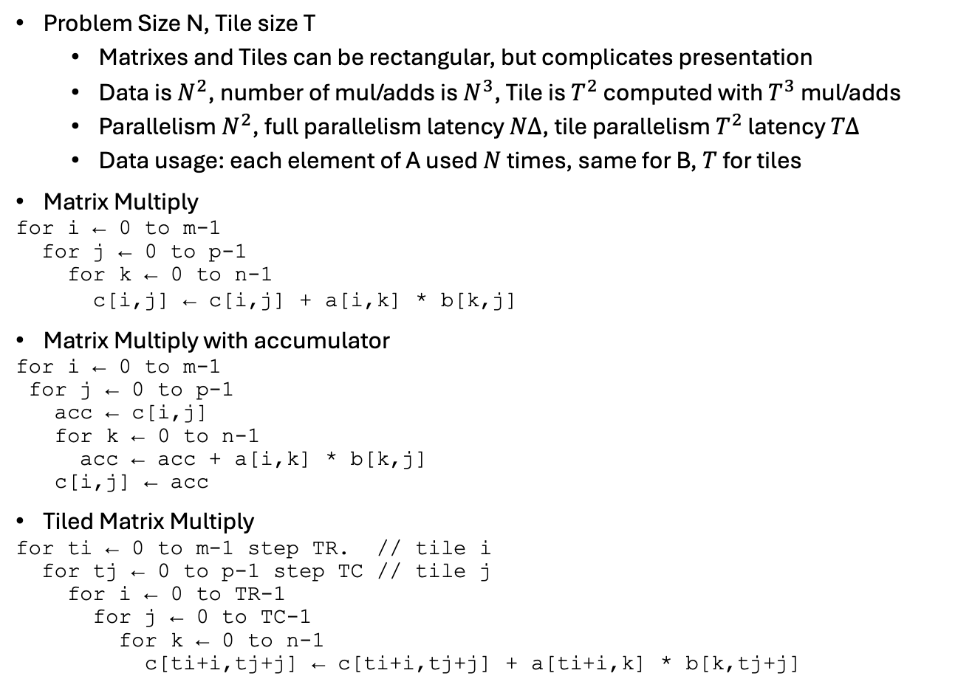
Preliminaries
Problem Size N, Tile size T
  Matrixes and Tiles can be rectangular, but complicates presentation
  Data is $N^{2}$, number of mul/adds is $N^{3}$, Tile is $T^{2}$ computed with $T^{3}$ mul/adds
  Parallelism $N^{2}$, full parallelism latency $NΔ$, tile parallelism $T^{2}$ latency $TΔ$
  Data usage: each element of A used $N$ times, same for B, $T$ for tiles
Matrix Multiply
for i ← 0 to m-1
for j ← 0 to p-1
for k ← 0 to n-1
c[i,j] ← c[i,j] + a[i,k] * b[k,j]
Matrix Multiply with accumulator
for i ← 0 to m-1
for j ← 0 to p-1
acc ← c[i,j]
for k ← 0 to n-1
acc ← acc + a[i,k] * b[k,j]
c[i,j] ← acc
Tiled Matrix Multiply
for ti ← 0 to m-1 step TR. // tile i
for tj ← 0 to p-1 step TC // tile j
for i ← 0 to TR-1
for j ← 0 to TC-1
for k ← 0 to n-1
c[ti+i,tj+j] ← c[ti+i,tj+j] + a[ti+i,k] * b[k,tj+j]
=
×

Slide 4
Goals
Energy efficiency
  Use load data as many times as reasonable per load
  Use register file reads as many times as reasonable per access
  Make storage local and small
Balancing load bandwidth and computation
  Make them equally limiting when reasonable
Scalability
  Expose parallelism so that implementations may exploit as much as they are willing to pay for
Cost
  Exploit pipelining to save area
  Keep storage proportional to benefit
Complexity
  Prefer simple instructions to complex ones when other things equal
    Avoid iteration in hardware when iteration in software works just as well
  Provide flexibility

Slide 5
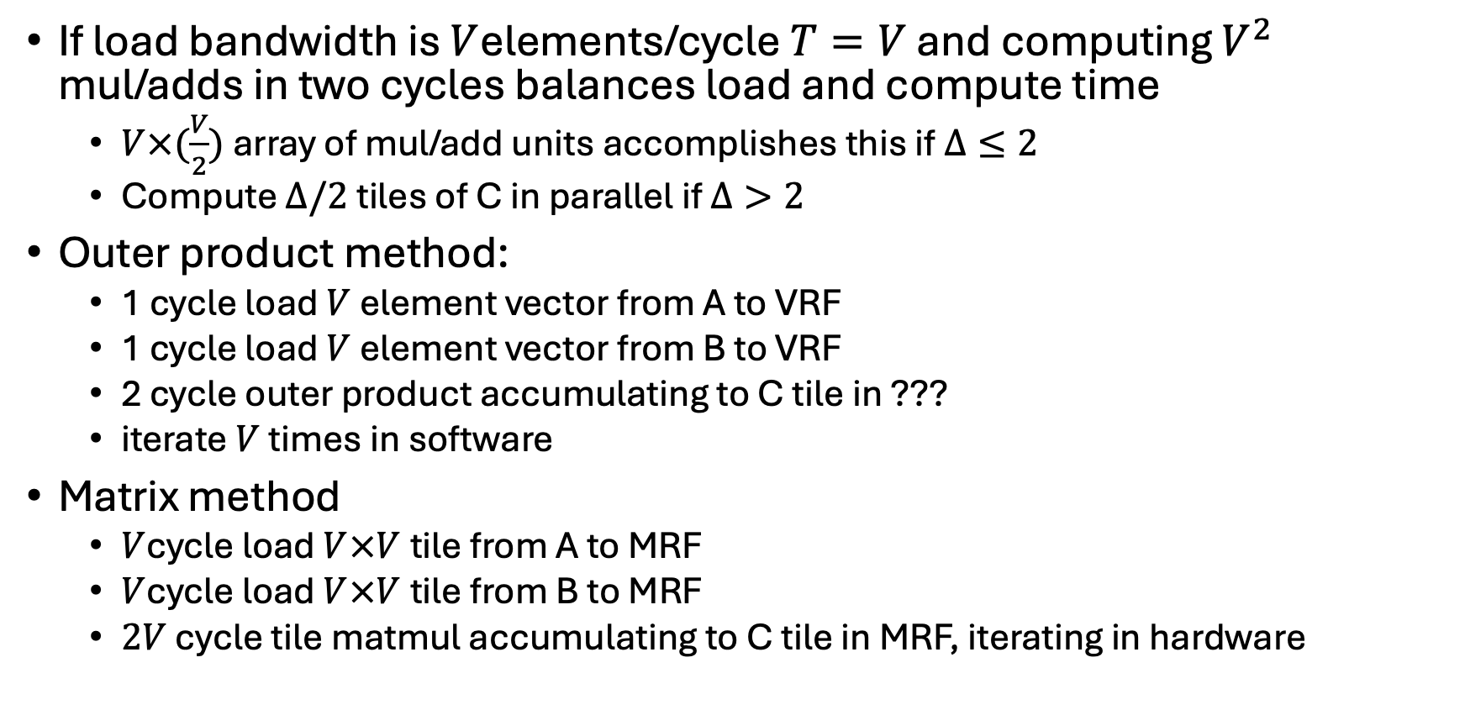
Balance Load and Compute
If load bandwidth is $V$elements/cycle $T=V$ and computing $V^{2}$ mul/adds in two cycles balances load and compute time
  $V×(\frac{V}{2})$ array of mul/add units accomplishes this if $Δ≤2$
  Compute $Δ/2$ tiles of C in parallel if $Δ>2$
Outer product method:
  1 cycle load $V$ element vector from A to VRF
  1 cycle load $V$ element vector from B to VRF
  2 cycle outer product accumulating to C tile in ???
  iterate $V$ times in software
Matrix method
  $V$cycle load $V×V$tile from A to MRF
  $V$cycle load $V×V$tile from B to MRF
  $2V$ cycle tile matmul accumulating to C tile in MRF, iterating in hardware

Slide 6
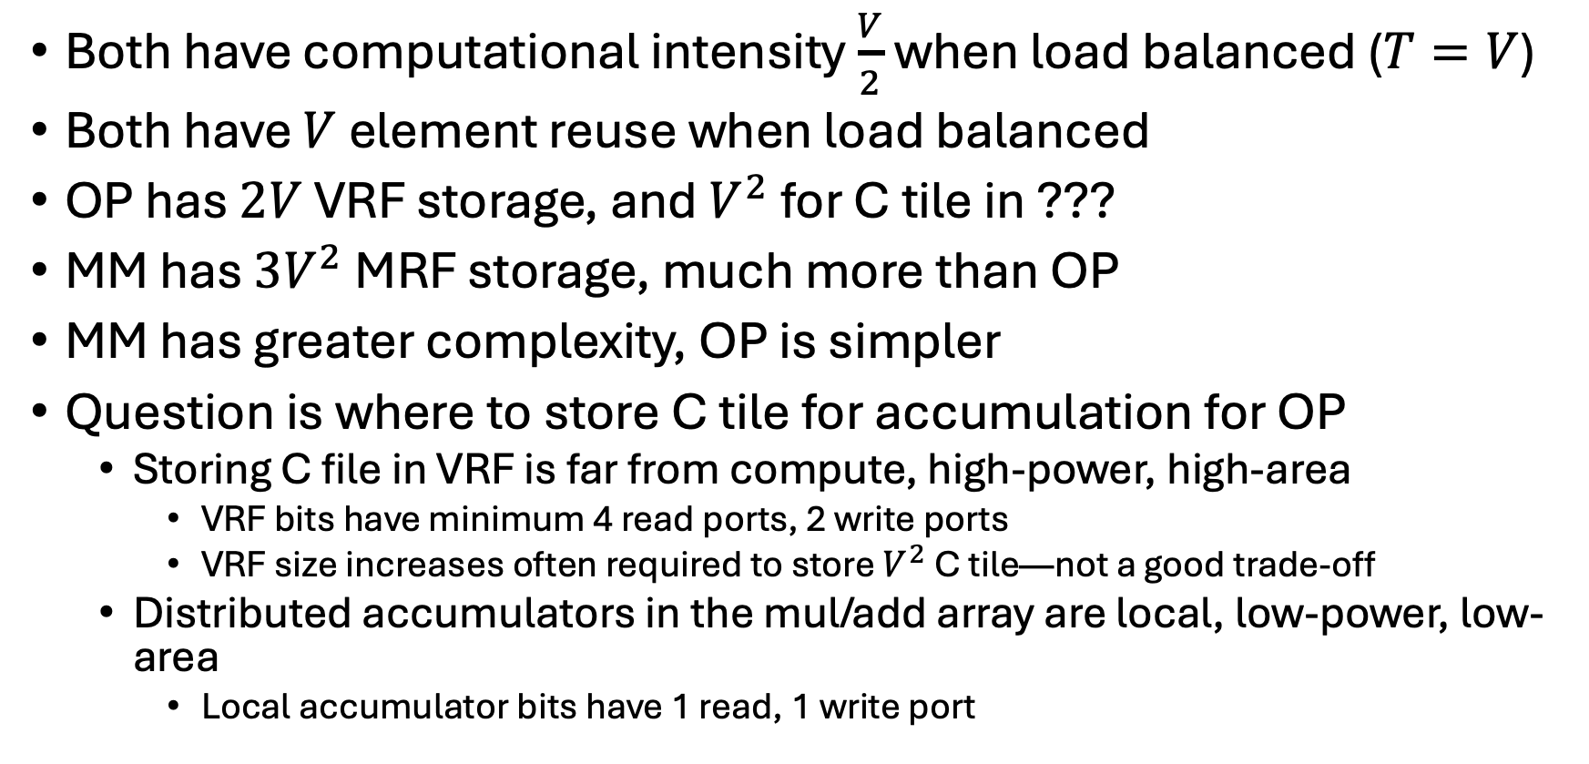
Outer Product (OP) vs Matrix Multiply (MM)
Both have computational intensity $\frac{V}{2}$ when load balanced ($T=V$)
Both have $V$ element reuse when load balanced
OP has $2V$ VRF storage, and $V^{2}$ for C tile in ???
MM has $3V^{2}$ MRF storage, much more than OP
MM has greater complexity, OP is simpler
Question is where to store C tile for accumulation for OP
  Storing C file in VRF is far from compute, high-power, high-area
    VRF bits have minimum 4 read ports, 2 write ports
    VRF size increases often required to store $V^{2}$ C tile—not a good trade-off
  Distributed accumulators in the mul/add array are local, low-power, low-area
    Local accumulator bits have 1 read, 1 write port

Slide 7
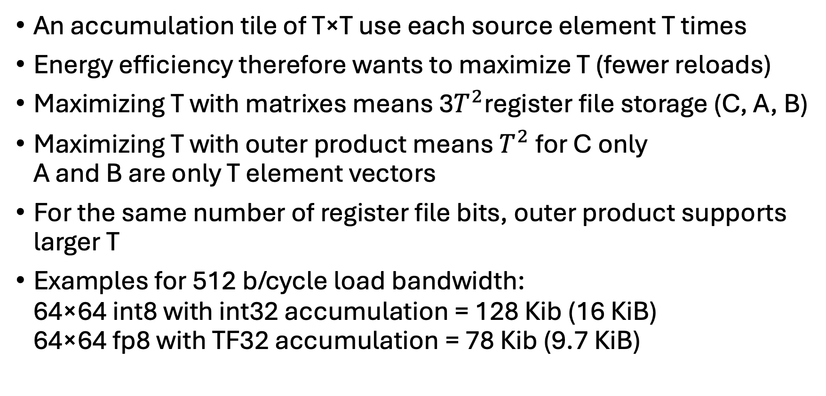
Using Memory Data Multiple Times
An accumulation tile of T×T use each source element T times
Energy efficiency therefore wants to maximize T (fewer reloads)
Maximizing T with matrixes means 3$T^{2}$register file storage (C, A, B)
Maximizing T with outer product means $T^{2}$ for C only
A and B are only T element vectors
For the same number of register file bits, outer product supports larger T
Examples for 512 b/cycle load bandwidth:
64×64 int8 with int32 accumulation = 128 Kib (16 KiB)
64×64 fp8 with TF32 accumulation = 78 Kib (9.7 KiB)

Slide 8


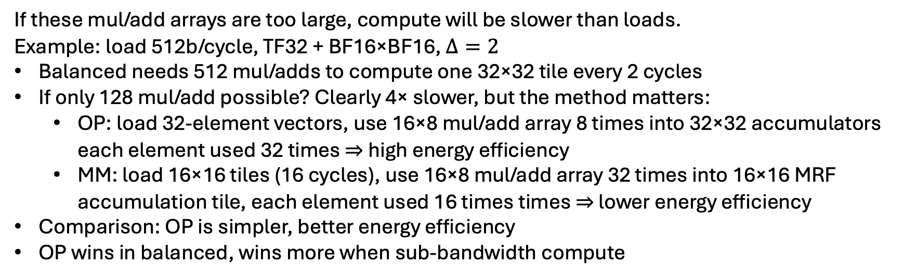
Less Compute Than Load Bandwith
$Δ≤2$ mul/add array sizes
$Δ=4$ mul/add array sizes
Load bits | 8b | 16b | 32b | 64b
256 | 32×16 | 16×8 | 8×4 | 4×2
512 | 64×32 | 32×16 | 16×8 | 8×4
Load bits | 8b | 16b | 32b | 64b
256 | 64×16 | 32×8 | 16×4 | 8×2
512 | 128×32 | 64×16 | 32×8 | 16×4
If these mul/add arrays are too large, compute will be slower than loads.
Example: load 512b/cycle, TF32 + BF16×BF16, $Δ=2$
Balanced needs 512 mul/adds to compute one 32×32 tile every 2 cycles
If only 128 mul/add possible? Clearly 4× slower, but the method matters:
  OP: load 32-element vectors, use 16×8 mul/add array 8 times into 32×32 accumulators
  each element used 32 times ⇒ high energy efficiency
  MM: load 16×16 tiles (16 cycles), use 16×8 mul/add array 32 times into 16×16 MRF accumulation tile, each element used 16 times times ⇒ lower energy efficiency
Comparison: OP is simpler, better energy efficiency
OP wins in balanced, wins more when sub-bandwidth compute

Slide 9
Proposed Instructions
msetcli rd, rs1, vtypei sets VL based on the number of columns specified in rs1 that can be processed by the v*outer.vv instructions and returns this value to rd.
msetrli rd, rs1, vtypei sets VL2 based on the number of rows specified in rs1 that can be processed by the v*outer.vv instructions and returns this value to rd.
vwouter.vv vs1, vs2 performs an integer widening outer product (acc ← acc + outerproduct(vs1, vs2)) for the current settings of SEW, VL, and VL2. Only VL columns and VL2 rows of the accumulators are modified.
vfouter.vv vs1, vs2 performs a floating-pointer outer product (acc ← acc + outerproduct(vs1, vs2)) for the current settings of SEW, VL, and VL2. Only VL columns and VL2 rows of the accumulators are modified.
vracc vd, rs1 reads the row of acc selected by rs1 and writes this to vd in the integer format selected by SEW using the length specified by VL. This transfer may involve some format conversion from the internal accumulator format to the specified integer format.
vfracc vd, rs1 reads the row of acc selected by rs1 and writes this to vd in the floating-point format selected by SEW using the length specified by VL. This transfer may involve some format conversion from the internal accumulator format to the specified integer format.
vrracc vd, rs1 reads the raw format row of acc selected by rs1 and writes this to vd as bytes as determined by acccolb.
vwacc rs1, vs2 writes the row of acc selected by by rs1 from vs2 in the integer format selected by SEW using the length specified by VL. This transfer may involve some format conversion to the internal accumulator format from the specified integer format.
vfwacc rs1, vs2 writes the row of acc selected by rs1 from vd in the floating-point format selected by SEW using the length specified by VL. This transfer may involve some format conversion to the internal accumulator format from the specified integer format.
vrwacc rs1, vs2 writes the raw format row of acc selected by rs1 from vs2 as bytes as determined by acccolb.

Slide 10
Conclusions
This analysis suggests
  Don’t store matrixes in VRF or MRF
  Accumulate into local mul/add array registers, not a distant register file
  Matrix extensions should optimize for
    Loading vectors
    Computing the outer product of these vectors
    Accumulate into local storage for energy savings
  Target a balance between load bandwidth and compute when possible
    Maintain element reuse when compute < load bandwidth for energy efficiency
  Other additions possible but this should be the core functionality

