Slide 1
Analytic Considerations for AME
Earl Killian 2025-04-15

Slide 2
Glossary
Δ | Add latency in cycles (e.g., $Δ=1$ for integer, $Δ=4$ for FP)
𝜂 | Computation Intensity 𝜂 = operations / element accesses
T | Used in this presentation for Tile dimension in elements (e.g., a tile of $T×T$ elements)
V | Used in this presentation for MLEN/SEW, i.e. the number of elements loaded per cycle
MAC | Multiply ACcumulate, e.g., as in the operation acc ← acc + x×y (a MAC is 2 operations)
OP | either Outer Product or OPeration (as in OPs/cycle)
DLEN | Datapath width in bits (this many bits of computation per cycle)
MLEN | Memory width in bits (this many bits per cycle), often MLEN=DLEN
VLEN | Vector Register width in bits (often VLEN=DLEN or DLEN×2)
SEW | Scalar Element Width in bits (the source data type width)
EEW | Effective Element Width in bits (EEW = $w×SEW$) (usually EEW=SEW, but SEW×2 for widening, SEW/2 for narrowing)
RVV | RISC-V Vector Extension
VRF | Vector Register File
LMUL | With LMUL=1, there are 32 vector registers (VRs) of VLEN bits each With LMUL>1 there are 32/LMUL VRs of VLEN×LMUL bits each
BLAS | Basic Linear Algebra Subroutines (a library standard)
BLIS | BLAS-like Library Instantiation Software (a package from UT Austin)
GEMM | BLAS lingo for GEneral Matrix Multiply ($C←αAB+βC$)
GEMV | BLAS lingo for GE Matrix Vector ($y←αAx+ βy$)
CSA and CPA | Carry-Save Adder and Carry-Propagate Adder

Slide 3
Issues I see for AME
Need to be analyzing AI Applications
AI data types are more demanding than FP32
Need more than just Matrix Multiply
Matrix×Vector is a problem (memory bandwidth limited)
AME needs to spend more time on this
Need attention to energy efficiency
Primary question is data reuse
Reducing accesses to each level of memory hierarchy (and wires)
Need to address memory layout issues
E.g., transpose and inner-product packing
Is ISA support required to make this efficient?
When is data layout flexible, when is it not?
When is “natural layout” important?
Inner product overused in proposals?
Yes, inner product may help address widening
However, it loses energy efficiency
Matrix Register Files not useful and yet still proposed

Slide 4
Context
Matrix multiplication is used in many areas
Some are small matrixes of wide numbers
Example: 3×3 for coordinate transform using FP32 or FP64
However, AI uses large matrixes, too big to fit on-chip
Data is narrow (e.g., 16, 8, 6, or 4 bits)
Much of progress in AI is going to narrower and narrower data types
More exponent bits, less precision appears most useful for AI
Issue: FP add latency (denoted Δ) typically 4, compared to 1 for integer
Issue: how to stream the matrix data from off-chip to the computation in an efficient way
Pressure for narrow data types comes from need to make streaming more efficient
Especially critical for gemv
Narrow data types are “widened” during computation
GPUs typically do FP32 ← FP32 + FP8 × FP8 (4× widening)
i.e. FP32 accumulation, but is this necessary (convenient for GPUs but…)?

Slide 5
Tiled Matrix Multiply
When matrixes are too big, matrix compute by tiles
In this presentation, use square tiles for exposition
Tile size(s) picked to fit different levels of memory hierarchy
Registers, L2 cache, LLC cache, etc.
For tiles C ← C + A×B, all $T×T$
Parallel portion: $T^{2}$ MACs (Outer Product)
Sequential portion: sum of Outer Products
$C=\sum_{l=1}^{K}{A_{∗,l}{⊗B}_{l,∗}}$
Performance proportional to $T^{2}$
Energy efficiency (load reuse) proportional to $T$
References to next level of memory reduced to $N/T$

Slide 6
A Few AI Data Types
Size | Name | Sign | Exponent | Precision hidden+stored | Comment
32 | FP32 | 1 | 8 | 1+23 | Single Precision
 | TF32 | 1 | 8 | 1+10 | Nvidia 4-element dot product
16 | FP16 | 1 | 5 | 1+10 | 2008 IEEE format for graphics
 | BF16 | 1 | 8 | 1+7 | Google Brain Float ~2017
8 | E5M2 | 1 | 5 | 1+2 | Open Compute Project
 | E4M3 | 1 | 4 | 1+3 | Open Compute Project
 | E8M0 | 0 | 8 | 1+0 | Open Compute Project
 | E0M7 | 1 | 0 | 7 | 8-bit integer Sb.bbbbbbb (int8)
6 | E3M2 | 1 | 3 | 1+2 | Open Compute Project
 | E2M3 | 1 | 2 | 1+3 | Open Compute Project
4 | E2M1 | 1 | 2 | 1+1 | Open Compute Project
 | E0M3 | 1 | 0 | 3 | 4-bit integer Sb.bbb (int4)
Other non-standard data types exist, e.g., k-quants, trits (−1,0,1)

Slide 7
Example Tile Sizes
C tile bits 𝑏 for efficient parallel computation for MLEN and SEW
SEW/dt MLEN | Δ=1 |  | Δ=4
 | int4 | int8 | FP4 | FP8 | FP16 | FP32 | FP64
 | $$w=8$$ | $$w=4$$ | $$w=8$$ | $$w=4$$ | $$w=2$$ | $$w=1$$
128 | 32768 | 8192 | 131072 | 32768 | 8192 | 2048 | 1024
256 | 131072 | 32768 | 524288 | 131072 | 32768 | 8192 | 4096
512 | 524288 | 131072 | 2097152 | 524288 | 131072 | 32768 | 16384
1024 | 2097152 | 524288 | 8388608 | 2097152 | 524288 | 131072 | 65536
$w$ is widening factor from source format (SEW) to accumulation format (EEW)
Note: small data types are much easier to compute but require much greater tile storage due to O($N^{2}$) elements computed with wide accumulation!
Note: pure FP4 and FP6 E2M3 can be done in integer (Δ=1, ¼ of $b$ above) if not mixed format. Note further: mixed format for AI may become common. Conclusion: AI trend towards small data types demands efficient C tile bits.

Slide 8
Wide vs. Narrow (Fat vs. Skinny) vs. Full
For MM by tiles, the common dimension of A and B (typically denoted $K$) is of great import
$K=1$ means that A is M×1 and B is 1×N, i.e., vectors i.e., C tile is the outer product of vectors of A and B
$K=2$ or $K=4$: C tile is sum of $K$ outer products, i.e., each $C_{ij}$ is a $K$-element inner product (a “narrow” or ”skinny” inner product MM)
Zvma AME proposal is one example of $k=4$ ISA
IME Option C is another example of $k=4$ for SEW=8
Larger $K$ (e.g., ≥8): might be called a “wide” or “fat” inner product MM
When K of similar magnitude to M,N: call this Full MM
Whether to target Outer Product, Narrow MM, Wide MM, or Full MM is a critical question

Slide 9
OPs/c ∝ C Tile Size, Reuse = Tile Dimension
If C is $T×T$, A is $T×k$, B is $k×T$, OPs = $2kT^{2}$, loads = $2kT$
For $k=1$ (Outer Product), each element loaded used $T$ times:
$C_{i,j}←C_{i,j}+A_{i,l}B_{l,j}$
$Δ_{1}$ cycles between adds to $C_{i,j}$
$η=\frac{2T^{2}}{2T}=T$
$\frac{T^{2}}{Δ_{1}}$ MACs over $Δ_{1}$ cycles to accumulate to each location, $\frac{{2T}^{2}}{Δ_{1}}$ OPs/c
For $k>1$, each element loaded used $T$ times ($k$ has no effect):
$C_{i,j}←C_{i,j}+A_{i,l+0}B_{l+0,j}$ $+A_{i,l+1}B_{l+1,j}$ $+⋯+A_{i,l+k−1}B_{l+k−1,j}$
$Δ_{k}$ cycles between adds to $C_{i,j}$
$η=\frac{2{kT}^{2}}{2kT}=T$
$\frac{T^{2}}{Δ_{k}}$ MACs over $Δ_{k}$ cycles to accumulate to each location, $\frac{{2kT}^{2}}{Δ_{k}}$ OPs/c
If $Δ_{k}=kΔ$, OPs/c same as O.P., $Δ_{k}<kΔ$ only justification
Integer $Δ_{k}<kΔ$ with carry-save adder (CSA) tree, same result
FP $Δ_{k}<kΔ$ with bulk normalization + CSA, different results
Often $Δ_{k}=Δ_{1}$ is possible

Slide 10
Using Memory Data Multiple Times
An C tile of $T×T$ Outer Product uses each source element $T$ times
Reduces cache/memory references from $N$ to $N/T$
Requires $wT^{2}$ storage (e.g., accumulators $w$ wider than source elements)
Energy efficiency therefore wants to maximize $T$ (fewer reloads)
Desirable to balance load and compute cycles—requires O($T^{2}$/Δ) MACs
Cost considerations want to minimize $T$
$T<V$ wastes memory bandwidth (at least for natural layout)
$T=V$ and $T=2V$ are good choices
Powers of two most practical, so $T=2^{e}V$ gives $2^{e+1}$ load cycles
$Δ=2^{d}=2^{e+1}⇒e=d−1$ using $\frac{T^{2}}{Δ}=\frac{2^{2e}V^{2}}{2^{d}}=2^{2e−d}V^{2}$MACs/c
For $Δ=1$, $T=V$ with $V×\frac{V}{2}$ MAC array; For $Δ=4$, $T=2V$ with $V×V$ MAC array
Maximizing $T$ with Full MM means $\left(w+2\right)T^{2}$register file storage (C, A, B)
Maximizing $T$ with Outer Product means only O($T^{2}$) storage for C tile
For the same number of register file bits, outer product supports larger $T$

Slide 11
Tiled Matrix Multiply (2)
Minimum time is $kΔ$ for same FP rounding
For data in registers
Time $kΔ+Δ−1$ achieved by $T^{2}/Δ$ pipelined MACs
Integer theoretically O($log⁡(k))$ but not practical for large $k$
FP rounding might be flexible, or not—how to decide?
Abandon same FP rounding to speed MM?
Larger $T$ vs. $\frac{{kΔ}_{1}}{Δ_{k}}$
Doubling $T$ gives 4× in OPs/cycle, doubles energy efficiency
Special inner product potential $\frac{{kΔ}_{1}}{Δ_{k}}$ OPs/c improvement
Should balance with memory bandwidth
Doesn’t improve energy efficiency

Slide 12
Vector vs. Matrix
Vector ISAs provide O(1) ops:data ratio
Most vector implementations provide 2:1 ops to load/store
Matched to Level 1 and Level 2 BLAS and many matrix operations (e.g., addition, scaling)
Matrix can outperform Vector by using more MAC units
Only useful for algorithms with high op to load/store ratios
More MACs irrelevant for gemv—time spent waiting for memory
For algorithms that benefit, each value loaded used many times
Target Level 3 BLAS, e.g., matrix multiply
M×M convolution
Motion search
Matrix operations for algorithms with small ratios are not useful
Elementwise operations not improved, just add latency
Examples: matrix addition, Hadamard product, scaling

Slide 13
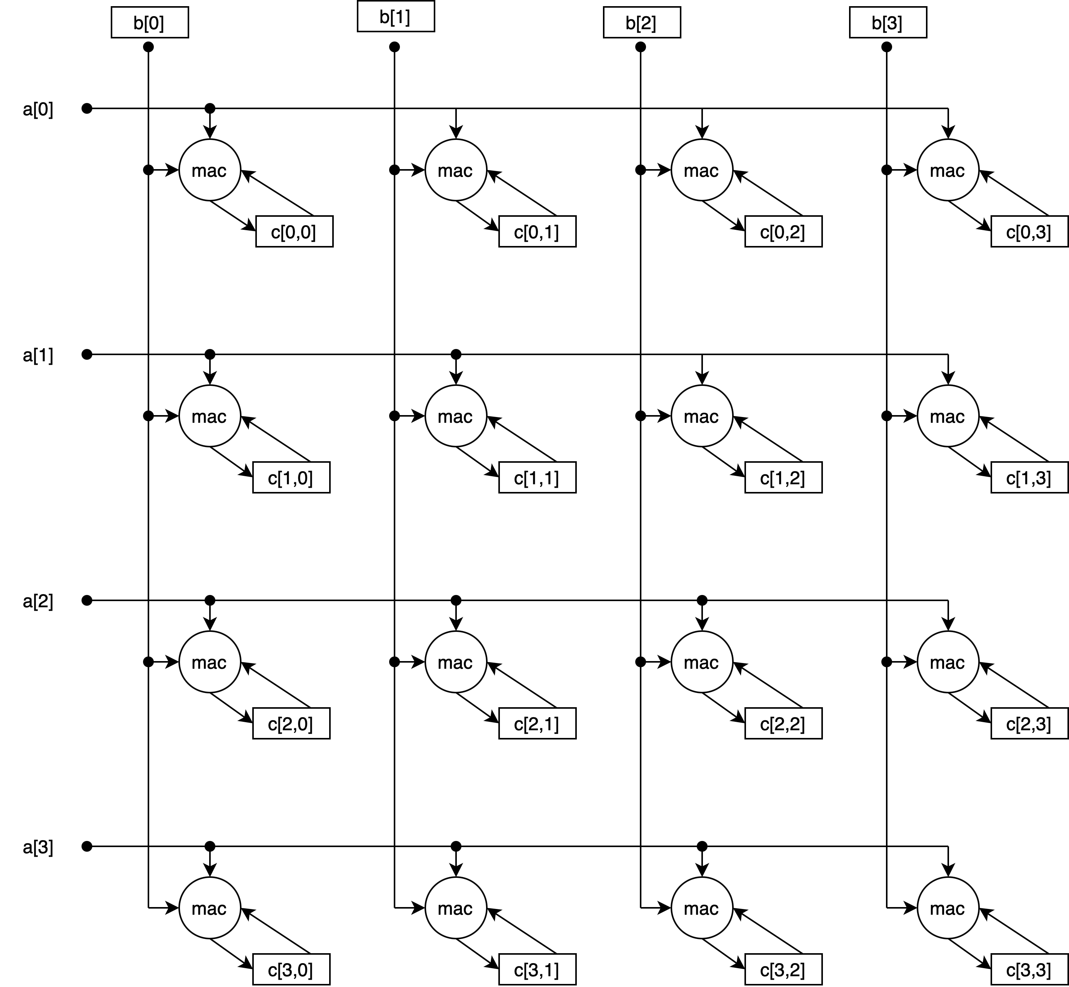
A 4×4 Outer Product Accumulator Array

Slide 14
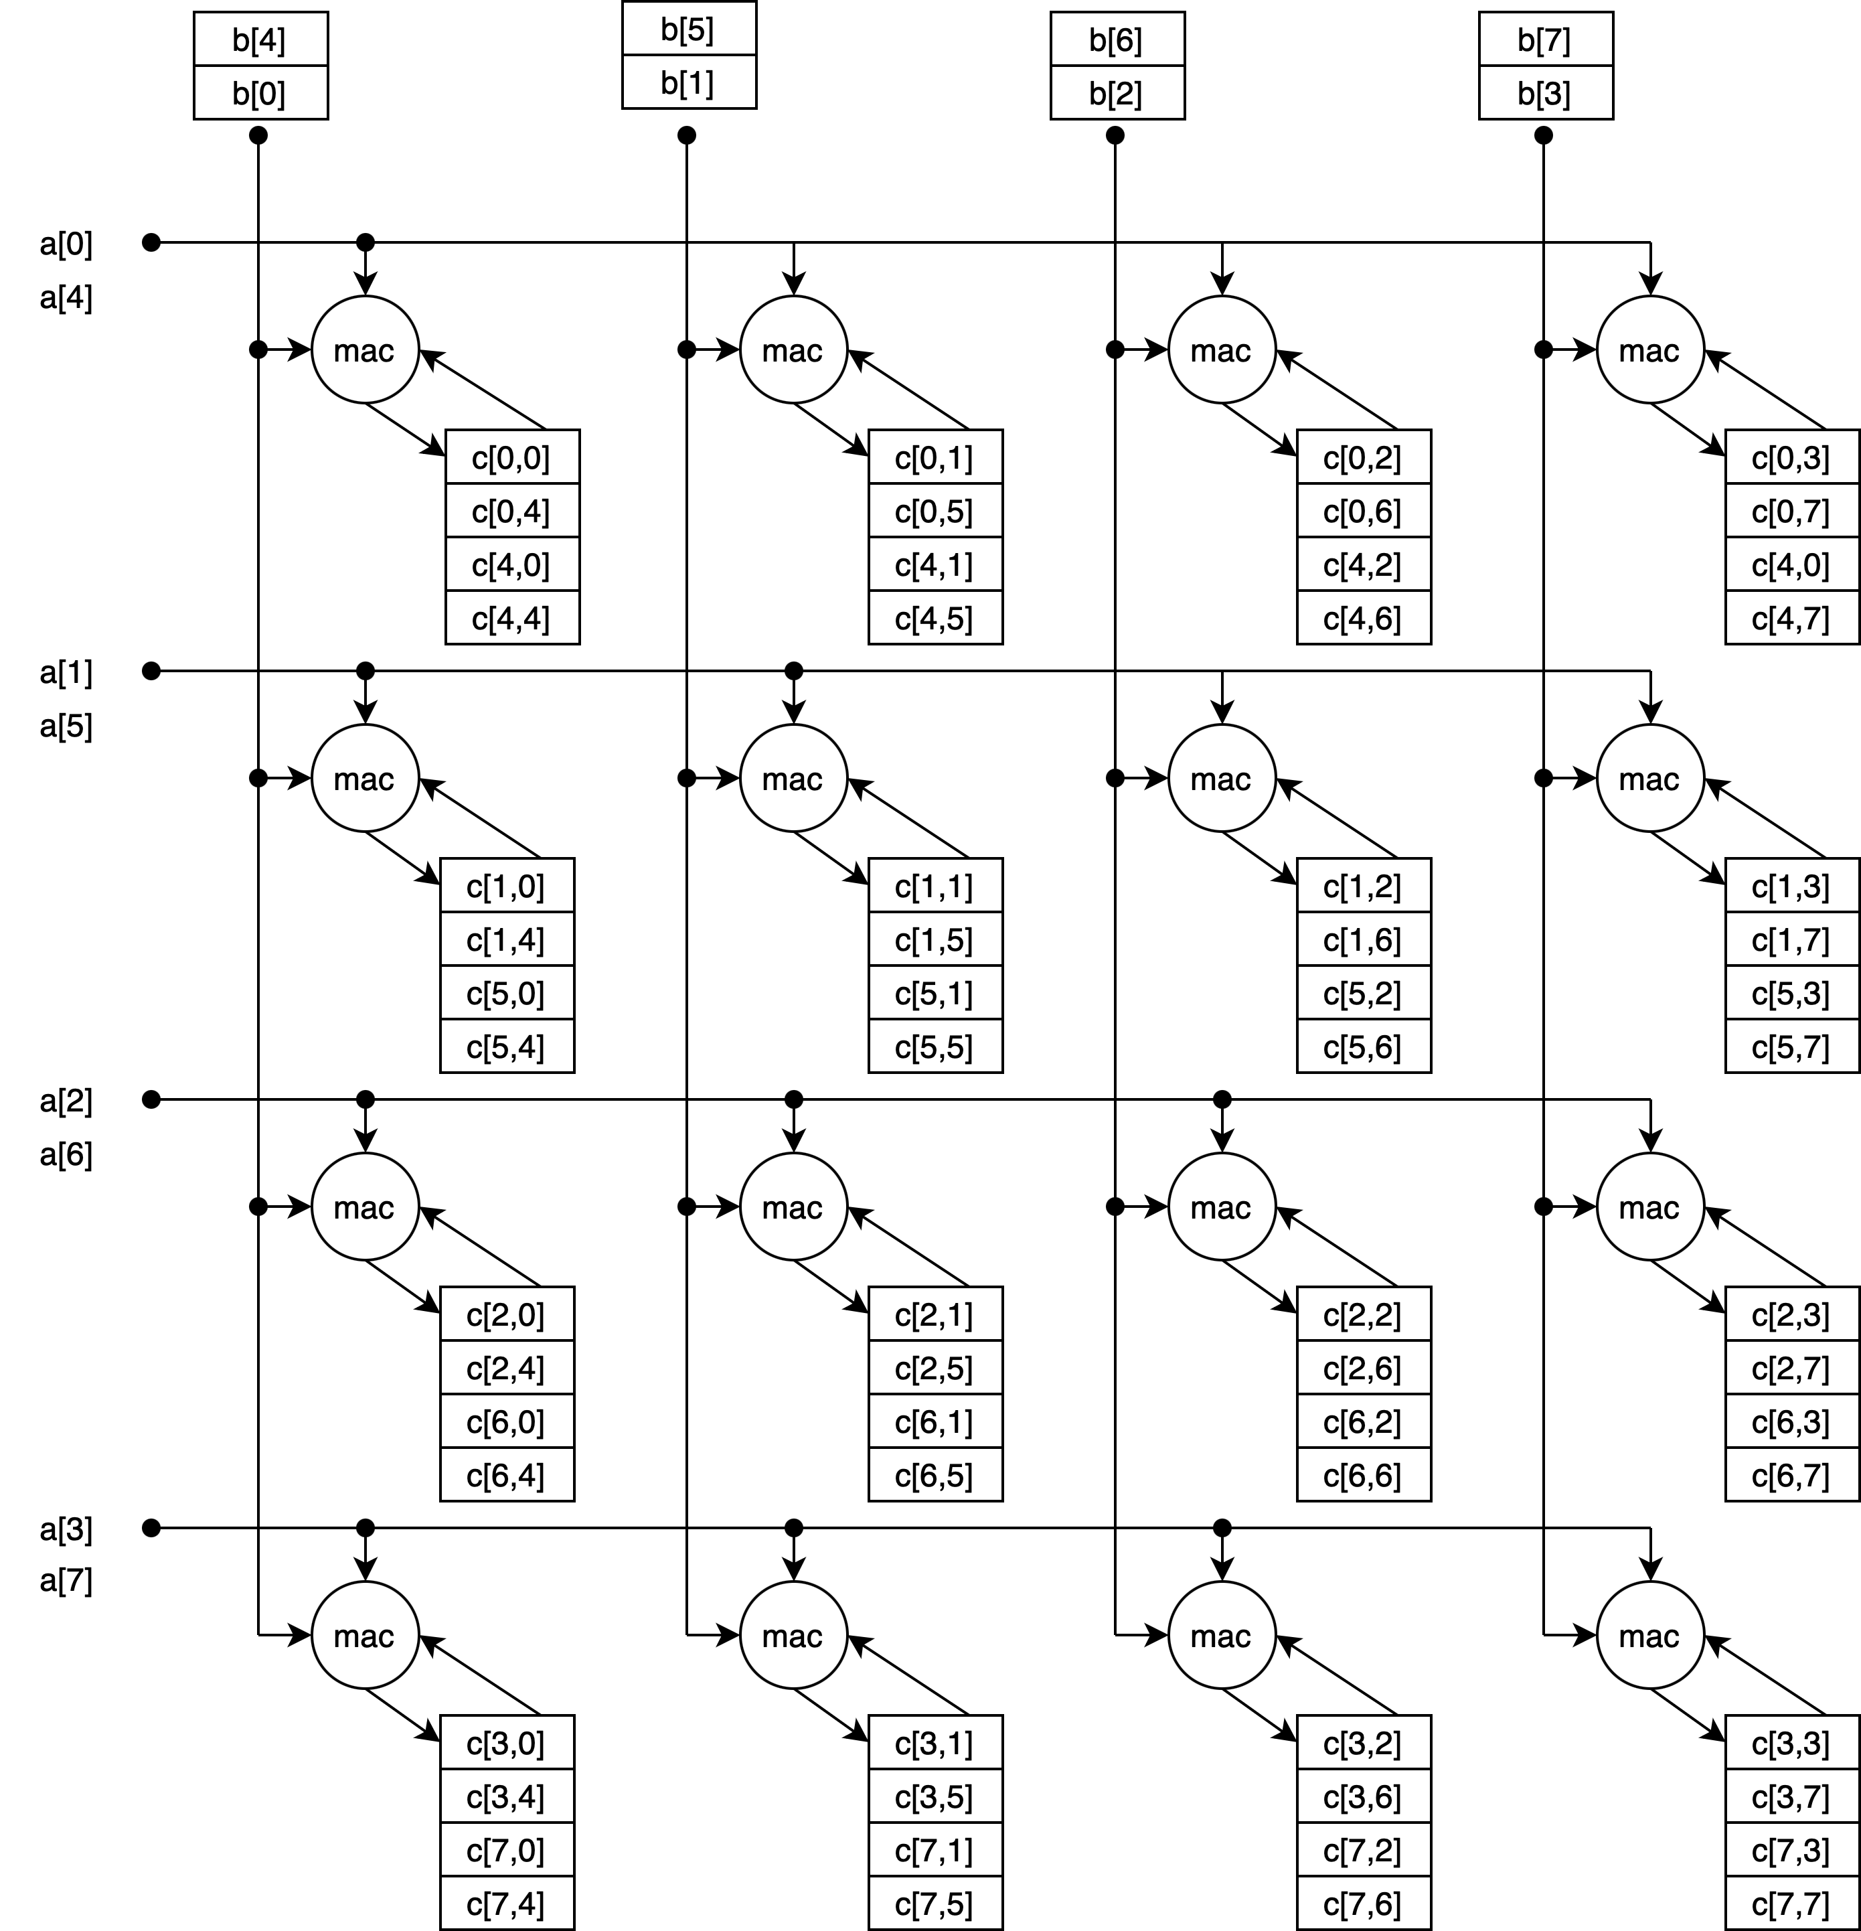
A 4×4 Outer Product MAC Array with 4 Accumulators per MAC (e.g., $Δ=4$)

Slide 15
Balanced Load/Compute for Load bandwidth $V$
 | Outer Product |  | Full Matrix Multiply
 | $$Δ≤2$$ | $$Δ≤4$$ | $$Δ≤2$$ | $$Δ≤4$$
Load A (elements) | $$V$$ | $$2V$$ | $$V×V$$ | $$2V×2V$$
Load B (elements) | $$V$$ | $$2V$$ | $$V×V$$ | $$2V×2V$$
Load to | VRF | VRF | MRF | MRF
Load cycles | 2 | 4 | $$2V$$ | $$8V$$
MAC array | $$V×\frac{V}{2}$$ | $$V×V$$ | $$V×\frac{V}{2}$$ | $$V×V$$
Compute cycles | 2 | 4 | $$2V$$ | $$8V$$
C tile ($w$ wider) | $$V×V$$ | $$2V×2V$$ | $$V×V$$ | 2$V×2V$
C tile location | 2 per MAC | 4 per MAC | MRF | MRF
Ops | $${2V}^{2}$$ | $$2{\left(2V\right)}^{2}$$ | $$2V^{3}$$ | $$2{\left(2V\right)}^{3}$$
Ops / cycle | $$\frac{2V^{2}}{2}=V^{2}$$ | $$\frac{8V^{2}}{4}=2V^{2}$$ | $$\frac{2V^{3}}{2V}=V^{2}$$ | $$\frac{16V^{3}}{8V}=2V^{2}$$
Intensity 𝜂 | $$\frac{2V^{2}}{2V}=V$$ | $$\frac{8V^{2}}{4V}=2V$$ | $$\frac{2V^{3}}{2V^{2}}=V$$ | $$\frac{16V^{3}}{8V^{2}}=2V$$
Storage | $$2V+wV^{2}$$ | $$4V+4wV^{2}$$ | $$2V^{2}+wV^{2}$$ | $$8V^{2}+4wV^{2}$$
Full MM same performance and intensity as OP, more storage, iteration in hardware vs. software

Slide 16
Conclusion: Outer Product vs. Full MM
Outer Product is uniformly superior to Full MM
Same performance
Same intensity
Less storage—C tile is only O($V^{2}$) storage, general MRF not required
Iteration in software rather than hardware
C tile location belongs in the MAC units
C file in VRF or separate MRF:
Far from compute
High-power
High-area (VRF bits have minimum 4 read ports, 2 write ports)
Need to increase VRF to hold ${wV}^{2}$ C tile
Distributed accumulators in the MAC array:
Local
Low-power
Low-area (1 read, 1 write port)

Slide 17
$T≥V$ Outer Product Tiles for Δ and Energy
T | Load cycles | $$Δ$$ | MAC array | OPs /cycle | Acc
$$V$$ | 2 | $$Δ≤2$$ | $$V×\frac{V}{2}$$ | $$V^{2}$$ | $$V^{2}$$
$$2V$$ | 4 | $$Δ≤4$$ | $$V×V$$ | $${2V}^{2}$$ | $${4V}^{2}$$
$$4V$$ | 8 | $$Δ≤8$$ | $$2V×V$$ | 4$V^{2}$ | $${16V}^{2}$$
$$8V$$ | 16 | $$Δ≤16$$ | $$2V×2V$$ | $${8V}^{2}$$ | $${64V}^{2}$$
Load cycles $≥Δ$ allow use of pipelined MACs
General case: $pV$ elements from A, $qV$ elements from B:
$p+q$ cycles for loads
C tile is $pqV^{2}$ elements
Problem: find s and t such that $p+q=\frac{pq}{st}≤Δ$ so that $sV×tV$ MAC array can be used to balance load cycles Practical solutions when powers of two used

Slide 18
Outer Product MAC Arrays for Reduced Area
MAC array | MAC cycles | $$Δ$$ | OPs /cycle | Acc /MAC | Acc
$$V×\frac{V}{2}$$ | 2 | $$Δ≤2$$ | $$V^{2}$$ | 2 | $$V^{2}$$
$$\frac{V}{2}×\frac{V}{2}$$ | 4 | $$Δ≤4$$ | $$\frac{V^{2}}{2}$$ | 4 | $$V^{2}$$
$$\frac{V}{2}×\frac{V}{4}$$ | 8 | $$Δ≤8$$ | $$\frac{V^{2}}{4}$$ | 8 | $$V^{2}$$
Logic area reduced
Accumulator area remains same ($∝wT^{2}$)
Save on accumulator area only by $T<V$ (throwing away load bandwidth)

Slide 19
Balanced $Δ≤2$ Outer Product Scalability
OPs /cycle | MAC cycles | $$\text{Load} \text{cycles}$$ | C Tile | Array | Acc /MAC | Acc
$$\frac{V^{2}}{4}$$ | 8 | 2 | $$V×V$$ | $$\frac{V}{2}×\frac{V}{4}$$ | 8 | $$V^{2}$$
$$\frac{V^{2}}{2}$$ | 4 | 2 | $$V×V$$ | $$\frac{V}{2}×\frac{V}{2}$$ | 4 | $$V^{2}$$
$$V^{2}$$ | 2 | 2 | $$V×V$$ | $$V×\frac{V}{2}$$ | 2 | $$V^{2}$$
$${2V}^{2}$$ | 4 | 4 | $$2V×2V$$ | $$V×V$$ | 4 | $${4V}^{2}$$
$${4V}^{2}$$ | 8 | 8 | $$4V×4V$$ | $$2V×V$$ | 8 | $${16V}^{2}$$
All performance points covered

Slide 20
Balanced $Δ=4$ Outer Product Scalability
OPs /cycle | MAC cycles | $$\text{Load} \text{cycles}$$ | C Tile | Array | Acc /MAC | Acc
$$\frac{V^{2}}{4}$$ | 8 | 2 | $$V×V$$ | $$\frac{V}{2}×\frac{V}{4}$$ | 8 | $$V^{2}$$
$$\frac{V^{2}}{2}$$ | 4 | 2 | $$V×V$$ | $$\frac{V}{2}×\frac{V}{2}$$ | 4 | $$V^{2}$$
$$V^{2}$$
$${2V}^{2}$$ | 4 | 4 | $$2V×2V$$ | $$V×V$$ | 4 | $$4V^{2}$$
$${4V}^{2}$$ | 8 | 8 | $$4V×4V$$ | $$2V×V$$ | 8 | $$16V^{2}$$
One performance point missing

Slide 21
Two Ways to Fill the Balanced $Δ=4$ Gap
OPs /cycle | k | MAC cycles | $$\text{Load} \text{cycles}$$ | C Tile | Array | Acc /MAC | Acc
$$\frac{V^{2}}{4}$$ | 1 | 8 | 2 | $$V×V$$ | $$\frac{V}{2}×\frac{V}{4}$$ | 8 | $$V^{2}$$
$$\frac{V^{2}}{2}$$ | 1 | 4 | 2 | $$V×V$$ | $$\frac{V}{2}×\frac{V}{2}$$ | 4 | $$V^{2}$$
$$V^{2}$$ | 2 | 4 | 4 | $$V×V$$ | $$\frac{V}{2}×\frac{V}{2}×2$$ | 4 | $$V^{2}$$
$$V^{2}$$ | 1 | 4 | 4 | $$2×V×V$$ | $$V×\frac{V}{2}$$ | 4 | $${2V}^{2}$$
$${2V}^{2}$$ | 1 | 4 | 4 | $$2V×2V$$ | $$V×V$$ | 4 | $${4V}^{2}$$
$${4V}^{2}$$ | 1 | 8 | 8 | $$4V×4V$$ | $$2V×V$$ | 8 | 16$V^{2}$
Either $k=2$ or two C tiles fill the missing performance point

Slide 22
Handling $Δ>2$ (really $Δ=4$)
$Δ>2$ supported by increasing MAC and load cycles
In balanced Outer Product, any $T>V$, primarily $T=2V$
Increases both load and MAC cycles
Alternative #1 is cutting MACs/cycle by 2×
Alternative #2 is doing two C tiles in parallel
Another way to increase load cycles is $k>1$
$k=2$ gives 4 load cycles
Two columns from A, two rows from B
$\frac{V}{2}×\frac{V}{2}$ array of 2-inner units gives $V^{2}$ OPs/cycle
4 accumulators per inner product unit (+ extra flops)
$k=4$ gives 8 load cycles
Four columns from A, four rows from B
$\frac{V}{2}×\frac{V}{4}$ array of of 4-inner units is $V^{2}$ OPs/cycle for $Δ=4$
8 accumulators per inner product unit (+ extra flops)

Slide 23
Comparison for $Δ≤2$: Outer Product vs. Skinny MM
Minimum tile size is the same for both ($T=V$) for $Δ≤2$
Tile size determines performance, $k$ has no effect
Tile size determines load reuse (energy efficiency), $k$ has no effect
Increasing $T$ (e.g., $2V$) is generally better than increasing $k$
Possible exception: packing multiple/rows columns into one V-element read in prior phase
Conclusion For $Δ≤2$
Same performance, intensity, storage
Outer Product simpler
2 vs. 8 cycle
No inner-product hardware
No complicated operand delivery

Slide 24
Observations for $Δ=4$: Outer Product vs. Skinny MM
Balanced O.P. uses $2V×2V$ with $2V^{2}$ OPs/cycle using pipelined MACs
2× performance, 2× intensity, 2× load use, 2× logic area, 4× storage
Often a good trade-off, but not always
Reduced performance O.P. goes to $\frac{V}{2}×\frac{V}{2}$ MAC array at $\frac{V^{2}}{2}$ OPs/cycle
Skinny $k$-inner MM ($k≥2$) has $2k$cycles of loads, so $Δ_{k}=4$ supported
Requires special inner-product hardware, likely $Δ_{k}>Δ_{1}$, extra pipe stages
Benefits from $2k$ VRF read ports (workaround exists—adds complexity)
Requires operand storage in MACs to save power on operand delivery
For $k=2$ or $k=4$, $T=V$ performance $V^{2}$ OPs/cycle
Between reduced MAC and $T=2V$outer product options
Useful only if this is your performance goal, otherwise more complex
For $k=4$, $T=2V$ (16 cycles of loads)
$V×\frac{V}{4}$ array of 4-inner product units gives $2V^{2}$ OPs/cycle
same as $T=2V$outer product
Potentially higher $Δ_{k}$ requiring extra pipeline stages and power

Slide 25
Conclusion: $Δ=4$ Outer Product vs. Skinny MM
Whether Outer Product or Skinny MM better for $Δ>2$ depends on performance/cost goals
For many cases, Outer Product is simpler and same performance
For one case, performance of Skinny MM, $V^{2}$ OPs/cycle, is between two Outer Product options ($½V^{2}$ for reduced MACs, $2V^{2}$for $T=2V$)
RISC-V should not force choice on implementation
Instead have, e.g., vsettk instruction, to indicate what $k$-value software should use

Slide 26
Why Inner Product Keeps Returning
Outer product has many nice properties
O($T^{2}$) performance makes it easy to target a wide range
Same FP rounding
But engineers sometimes augment O.P. with inner product
One reason is widening
Small data types are multiplied, and accumulated in higher precision, e.g., FP32 ← FP32 + FP8×FP8 ($w=4$)
RVV not well-suited for >2× widening
e.g., IME proposal to add fat inner product to RVV reduces accumulation tile size to support widening
FP32 adder naturally lays out wider than FP8 multiplier
Tempting to put 4 FP8 multipliers in the width of one FP32 adder
Another reason is handling $Δ>2$ when $T=2V$ is too big
Finally, to improve OPs/c when $Δ_{k}<kΔ_{1}$ and $T>V$

Slide 27
Outer Product Layout
 |  |  | Vector Register File
 |  |  |  |  |  |  |  |  |  |  |  |  |  |  |  |  |  |  |  |  |  |  |  |  |  |  | A vector vertical B vector horizontal Very long wires
 |  |  | Vector Datapath
 |  |  |  |  |  |  |  |  | ⋯
 |  |  |  |  |  |  |  |  | ⋯
 |  |  |  |  |  |  |  |  | ⋯
 |  |  |  |  |  |  |  |  | ⋯
 |  |  | ⋮ |  |  | ⋮ |  |  | ⋮ |  |  | ⋮ |  |  | ⋮ |  |  | ⋮ |  |  | ⋮ |  |  | ⋮
 |  |  |  |  |  |  |  |  | ⋯

Slide 28
Skinny $k=2$ Layout
 |  |  | Vector Register File
 |  |  |  |  |  |  |  |  |  |  |  |  |  |  |  |  |  |  |  |  |  |  |  |  |  |  | A vector vertical B vector horizontal Very long wires
 |  |  | Vector Datapath
 |  |  |  |  |  |  |  |  | ⋯
 |  |  |  |  |  |  |  |  | ⋯
 |  |  |  |  |  |  |  |  | ⋯
 |  |  |  |  |  |  |  |  | ⋯
 |  |  | ⋮ |  |  | ⋮ |  |  | ⋮ |  |  | ⋮ |  |  | ⋮ |  |  | ⋮ |  |  | ⋮ |  |  | ⋮
 |  |  |  |  |  |  |  |  | ⋯

Slide 29
Skinny MM $k=4$ Layout
 |  |  | Vector Register File
 |  |  |  |  |  |  |  |  |  |  |  |  |  |  |  |  |  |  |  |  |  |  |  |  |  |  | A vector vertical B vector horizontal Very long wires
 |  |  | Vector Datapath
 |  |  |  |  |  |  |  |  | ⋯
 |  |  |  |  |  |  |  |  | ⋯
 |  |  |  |  |  |  |  |  | ⋯
 |  |  |  |  |  |  |  |  | ⋯
 |  |  | ⋮ |  |  | ⋮ |  |  | ⋮ |  |  | ⋮ |  |  | ⋮ |  |  | ⋮ |  |  | ⋮ |  |  | ⋮
 |  |  |  |  |  |  |  |  | ⋯

Slide 30
Balanced Load/Compute for Load bandwidth V
 | Outer Product |  | Skinny Matrix Multiply ($k$-inner)
 | $$Δ≤2$$ | $$Δ≤4$$ | $$Δ_{k}≤2k$$
Load A (elements) | $$V$$ | $$2V$$ | $$kV$$
Load B (elements) | $$V$$ | $$2V$$ | $$kV$$
Load to | VRF | VRF | VRF
Load cycles | 2 | 4 | $$2k$$
MAC array | $$V×\frac{V}{2}$$ | $$V×V$$ | $$\left(\frac{V}{2}\right)×\left(\frac{V}{k}\right)×k$$
Compute cycles | 2 | 4 | $$2k$$
C tile ($w$ wider) | $$V×V$$ | $$2V×2V$$ | $$V×V$$
C tile location | 2 per MAC | 4 per MAC | $2k$ per MAC
Ops | $${2V}^{2}$$ | $$2{\left(2V\right)}^{2}$$ | $${2kV}^{2}$$
Ops / cycle | $$\frac{2V^{2}}{2}=V^{2}$$ | $$\frac{8V^{2}}{4}=2V^{2}$$ | $$\frac{2kV^{2}}{2k}=V^{2}$$
Intensity 𝜂 | $$\frac{2V^{2}}{2V}=V$$ | $$\frac{8V^{2}}{4V}=2V$$ | $$\frac{2kV^{2}}{2kV}=V$$
Storage | $$2V+wV^{2}$$ | $$4V+4wV^{2}$$ | $$2kV+wV^{2}$$

Slide 31
My Opinions

Slide 32
AME Should Build On a RVV Subset
RVA processors have RVV, need a high-end performance MM option
IME is good, but not great – need great against other ISAs
RVV processors have or often have
High-performance cache hierarchy useful for tiling
Multiprocessor support, useful for MM
RVV provides
Vector Load/Store for Outer Product
Vector Operations for O(1) ratio kernels
Framework for scalable ISA
RVV outer-product needs an accumulators to be great
Subset addresses concerns about RVV complexity

Slide 33
Possible RVV Subset as AME Base
Discussion starting point
RVV processors will support more, but AME-only need not
Can be remote from cores
vset*, context switch
Vector Register File (VRF)
Including LMUL
No masking
v{l,s}e{8,16,32,64}.v
No strided, indexed, segmented, FF, etc.
v{,w,n}{,f}op.v{v,x,f}
op includes most RVV ops
MACs, add/subtract, converts, moves, reductions, slide, etc.
Divide, sqrt need discussion (softmax)
Leave out iota, gather, compress, crypto

Slide 34
What Should Be In AME
Architectural state for accumulators
Instructions that accumulate the outer product of two vectors in an 2D tile local to the MAC units
Optional support for $k=2$ and $k=4$ skinny MM
Instructions to read accumulators sequentially by row to VRF
Unclear whether store from accumulators useful
Instructions to write accumulators by row and column from VRF
Write by column for transpose
Instructions to support prefetching and packing tiles from A and B tiles into the LLC and L2
Supporting >2× widening for gemv and mixed data types

Slide 35
What Should be Optional in AME
AME should be based on
Classic Outer Product ($k=1$);
Optional Skinny Matrix Multiply (e.g., $k=2$ or $k=4$), i.e., outer products of 4-inner product
The choice should up to the implementer
i.e., use of the inner-product should be optional

Slide 36
What Should Not Be in AME
Matrix storage other than accumulation tile(s)
Matrix Register File not useful
Matrix addition, etc.
Just use RVV, it handles these at memory bandwidth speeds just fine

Slide 37
Future Work
Where should we spend our time?
Looking for ways to apply more MACs to other high op:data algorithms
M×M Convolution (consider alternatives to im2col such as SConv)
Motion search
Best way to prefetch and pack tiles for caches and operand read
TGs may not have spent enough time on this?
Need to support widening for gemv better than RVV
What precision is really required for accumulators
Research question
How to speed up gemv — it will dominate when gemm supported by AME
gemv is memory bandwidth limited: perhaps compression?

Slide 38
My proposed starting point for AI
Base
mset{m,n,k}li rd, rs1, vtypei —Set M,N,K from App Dims
v{,f}op{,acc}.avv ma0, vs1, vs2—Outer Product integer/FP
v{,f,r}raccr vd, ma0 — Read accumulator integer/FP/RAW
v{,f,r}waccr rs1, vs2, ma0 —Write accumulator row
v{,f}waccc rs1, vs2, ma0 —Write accumulator column
v{,f}macc.avx ma0, vs1, rs2 —Vector MAC using acc (for gemv)
Need additions for convolution, packing, prefetch, etc.
Based on application benchmarking

Slide 39
Backup

Slide 40
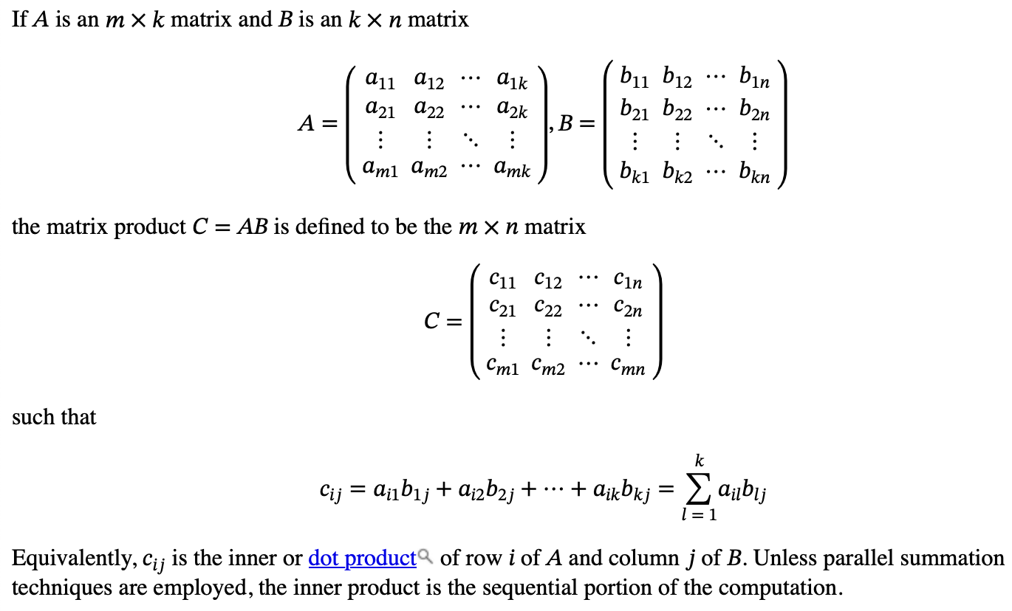
Notation
Primary purpose here is to introduce the BLAS M, N, K convention
and show MM as $mn$ inner products

Slide 41
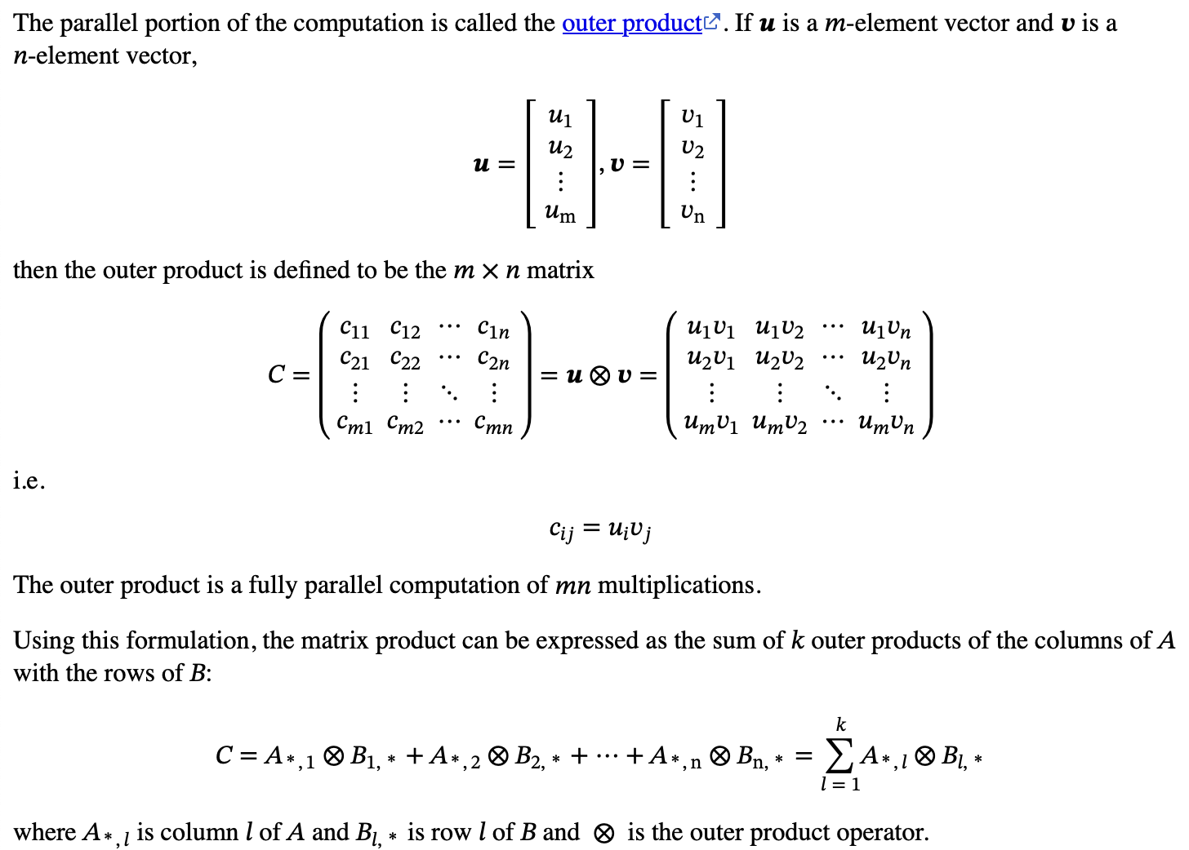
Notation (continued)
Key point is that MM can be seen as a sum of outer products

Slide 42
 |  |  |  |  |  |  |  |  |  |  |  |  |  |  |  |  |  |  |  |  |  |  |  |  |  |  | N |  |  | $$j$$
 | $C_{i,j}$ is the inner product of row $i$ of A and column $j$of B:
 |  | $$C_{i,j}=\sum_{l=1}^{K}{A_{i,l}B_{l,j}}$$ | $$C_{i,j}=\sum_{l=1}^{K}{A_{i,l}B_{l,j}}$$
 |  |  |  |  |  |  |  |  |  |  |  |  |  |  |  |  |  |  |  |  | K
 | Each $C_{i,j}$ can be computed in parallel. The sums to do so are generally sequential.
 |  |  |  |  |  |  |  |  |  |  |  |  |  | K |  |  |  |  |  |  |  |  |  |  |  |  |  |  |  | $$j$$
 |  |  |  |  |  |  |  |  | $$i$$ |  |  |  |  |  |  |  |  |  |  |  | $$i$$
 |  |  |  |  |  |  |  |  | M |  |  |  |  |  |  |  |  |  |  |  | M
 |  |  |  |  |  |  |  |  |  |  |  |  |  |  |  |  |  |  |  |  |  |  |  |  |  |  |  | N

Slide 43
 |  |  |  |  |  |  |  |  |  |  |  |  |  |  |  |  |  |  |  |  |  |  |  |  |  | N
$C$ is the sum of the outer products of column $l$ of A and row $l$of B:
 |  | $$C=\sum_{l=1}^{K}{A_{∗,l}{⊗B}_{l,∗}}$$
 |  |  |  |  |  |  |  |  |  |  |  |  |  |  |  |  |  |  |  | K
 |  |  |  |  |  |  |  |  |  |  |  |  | K
 |  |  |  |  |  |  |  | M |  |  |  |  |  |  |  |  |  |  |  | M
 |  |  |  |  |  |  |  |  |  |  |  |  |  |  |  |  |  |  |  |  |  |  |  |  |  |  | N

Slide 44
The Stationary Concept
The schoolbook MM method
for i ← 0 to m-1 for j ← 0 to n-1 for l ← 0 to k-1 c[i,j] ← c[i,j] + a[i,l] * b[l,j]
The i,j,l loops can be done in six different orders
Each ordering has different characteristics
The outer two loops determine which of A, B, or C is “stationary”: i.e., indexes unchanging in the inner loop
The schoolbook method makes C stationary
c[i,j] held in register, so load from A, load from B, MAC
Loads and stores of c[i,j] are in j loop, not the inner loop
Order l,j,i makes B stationary
b[l,j] held in register, so load from C, load from A, MAC, store C

Slide 45
C Usually Made Stationary
If A or B is stationary, references to C require load and store rather than just load
For AI data types C is often wider than A and B
e.g., FP8 A, FP8 B, FP32 C means 4 bytes to load, 4 bytes to store for C vs. 1 byte loads for A and B—an 8:1 ratio

Slide 46
Balanced Load/Compute Δ≤2
 | Outer Product | Skinny MM ($k$-inner) | Full MM
Load A (elements) | $$V$$ | $$kV$$ | $$V×V$$
Load B (elements) | $$V$$ | $$kV$$ | $$V×V$$
Element Use | $$V$$ | $$V$$ | $$V$$
Load/MAC cycles | 2 | $$2k$$ | $$2V$$
MAC array | $$V×\frac{V}{2}$$ | $$\left(\frac{V}{2}\right)×\left(\frac{V}{k}\right)×k$$ | $$V×\frac{V}{2}$$
C tile ($w$ wider) | $$V×V$$ | $$V×V$$ | $$V×V$$
C tile location | 2 per MAC | $2k$ per $k$-inner | MRF
Ops | $${2V}^{2}$$ | $${2kV}^{2}$$ | $$2{\left(2V\right)}^{3}$$
Ops / cycle | $$\frac{2V^{2}}{2}=V^{2}$$ | $$\frac{2kV^{2}}{2k}=V^{2}$$ | $$\frac{16V^{3}}{8V}=2V^{2}$$
Intensity 𝜂 | $$\frac{2V^{2}}{2V}=V$$ | $$\frac{2kV^{2}}{2kV}=V$$ | $$\frac{16V^{3}}{8V^{2}}=2V$$
Storage | $$2V+wV^{2}$$ | $$2kV+wV^{2}$$ | $$8V^{2}+4wV^{2}$$
xxx

Slide 47
Balanced Load/Compute Δ≤4
 | Outer Product | Skinny MM ($k$-inner) | Skinny MM ($k$-inner) | Full MM
Load A (elements) | $$2V$$ | $$kV$$ | 2$kV$ | $$2V×2V$$
Load B (elements) | $$2V$$ | $$kV$$ | $$2kV$$ | $$2V×2V$$
Element Use | $$2V$$ | $$V$$ | 2$V$ | $$2V$$
Load/MAC cycles | 4 | $$2k$$ | $$4k$$ | $$8V$$
MAC array | $$V×V$$ | $$\left(\frac{V}{2}\right)×\left(\frac{V}{k}\right)×k$$ | $$V×\left(\frac{V}{k}\right)×k$$ | $$V×V$$
C tile ($w$ wider) | $$2V×2V$$ | $$V×V$$ | $$2V×2V$$ | 2$V×2V$
C tile location | 4 per MAC | $2k$ per $k$-inner | $2k$ per $k$-inner | MRF
Ops | $$2{\left(2V\right)}^{2}$$ | $${2kV}^{2}$$ | $${8kV}^{2}$$ | $$2{\left(2V\right)}^{3}$$
Ops / cycle | $$\frac{8V^{2}}{4}=2V^{2}$$ | $$\frac{2kV^{2}}{2k}=V^{2}$$ | $$\frac{8kV^{2}}{4k}={2V}^{2}$$ | $$\frac{16V^{3}}{8V}=2V^{2}$$
Intensity 𝜂 | $$\frac{8V^{2}}{4V}=2V$$ | $$\frac{2kV^{2}}{2kV}=V$$ | $$\frac{8kV^{2}}{4kV}=2V$$ | $$\frac{16V^{3}}{8V^{2}}=2V$$
Storage | $$4V+4wV^{2}$$ | $$2kV+wV^{2}$$ | $$4kV+4wV^{2}$$ | $$8V^{2}+4wV^{2}$$
xxx

Slide 48
Balanced Δ≤2, V=64, SEW=8, w=4, k=4
 | Outer Product | Skinny MM (4-inner) | Full MM
Load A (elements) | 64 | 256 | 4096
Load B (elements) | 64 | 256 | 4096
Element Use | 64 | 64 | 64
Load/MAC cycles | 2 | 8 | 128
MAC array | 64×32 | 32×16 | 64×32
C tile ($w$ wider) | 64×64 | 64×64 | 64×64
C tile location | 2 per MAC | 8 per 4-inner | MRF
Ops | 8192 | 32768 | 524288
Ops / cycle | 4096 | 4096 | 4096
Intensity 𝜂 | 64 | 64 | 64
Storage | 132096 | 135168 | 196608
xxx

Slide 49
Balanced Δ=4, V=64, SEW=8, w=4, k=4
 | Outer Product | Skinny MM ($4$-inner) | Skinny MM ($4$-inner) | Full MM
Load A (elements) | 128 | 256 | 512 | 16384
Load B (elements) | 128 | 256 | 512 | 16384
Element Use | 128 | 64 | 128 | 128
Load/MAC cycles | 4 | 8 | 16 | 512
MAC or 4-inner array | 64×64 (4096 MACs) | 32×16×4 (2048 MACs) | 64×16×4 (4096 MACs) | 64×64 (4096 MACs)
C tile (32 bit) | 128×128 (16384) | 64×64 (4096) | 128×128 (16384) | 128×128 (16384)
C tile location (bits) | 4 per MAC (524288) | 8 per MAC (131072) | 16 per MAC (524288) | MRF (524288)
Ops | 32768 | 32768 | 131072 | 4194304
Ops / cycle | 8192 | 4096 | 8192 | 8192
Intensity 𝜂 | 128 | 64 | 128 | 128
Storage | 526336 | 133120 | 532480 | 786432
xxx

Slide 50
Inner Product
Integer addition is commutative and associative: ((A+B)+C)+D = (A+B)+(C+D)
Floating-point addition is not associative: (A+B)+C ≠ A+(B+C) due to rounding
Carry-Save Adders (CSAs) can reduce N integer sums to two in log time
Sum of 3 bits has values 0-3, so fits in 2 bits
Tree of 3-to-2 CSAs reduces many sums to just 2
Final carry-propagate add sums the 2 values
FP “bulk normalization” lets FP use CSA trees, but a different rounding results
Issue: does floating-point matrix multiply need to get the same rounding as schoolbook algorithm?
Integer not an issue, but FP is preferred data format

Slide 51
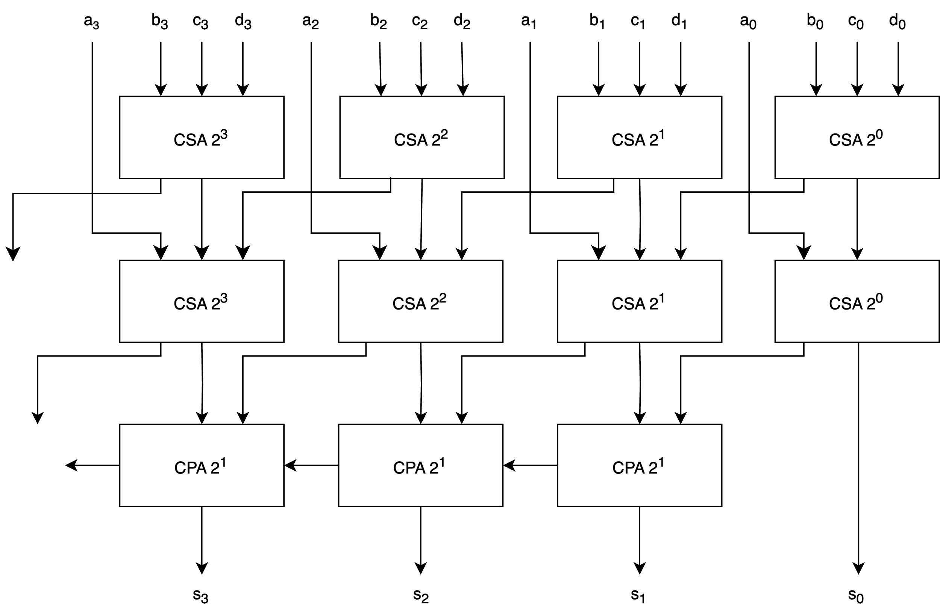
Carry-Save Adder (CSA) Tree

Slide 52
VLSI Layout
VLSI works best when regular structures used
Minimizes problems in routing wires, minimizes area/delay
 |  |  |  | 63 |  |  |  |  |  |  |  |  | 0
 |  | Decode |  | Register File
 |  |  |  |  |  |  |  |  |  |  |  |  |  |  |  |  | Examples: Integer and Floating-Point Units
 |  |  |  | 63 |  |  |  |  |  |  |  |  | 0
 |  | Control |  | Datapath
 |  |  |  |  |  |  |  |  |  |  |  |  |  |  |  |  | Register files characterized by bit width number of entries number of read ports number of write ports

Slide 53
Vector Layout
 |  |  | 63 |  |  | 0
 | Decode |  | RF |  |  |  |  | Buffer |  | RF |  |  |  |  |  |  | RF |  |  |  |  |  |  | RF
 |  |  | Cross-datapath communication
 | Control |  | Datapath |  |  |  |  | Buffer |  | Datapath |  |  |  |  |  |  | Datapath |  |  |  |  |  |  | Datapath

Slide 54
Solution: Matrix multiply by tiles
The same equations and loops apply when $C_{ij}$, $A_{il}$, and $B_{lj}$are scalars or matrixes
For example, pick a $s×t$ C tile which is the sum of products of $s×r$ tiles of A with $r×t$ tiles of B
If $s×r$ and $r×t$ tiles are sized to fit in L2 and/or LLC, the data is used multiple times, reducing references to DRAM
 |  |  |  |  | n |  |  |  |  |  |  |  |  |  |  | k |  |  |  |  |  |  |  |  | 𝑗 |  | n
m |  |  |  |  |  |  |  |  |  | = | m |  |  |  |  |  |  |  |  |  | × | k |  |  | t
 |  |  | t |  |  |  |  |  |  |  |  |  |  |  |  |  | r |  |  |  |  |  |  | r | 𝑙,𝑗 |  |  |  |  |  |  | 𝑙
 |  | s | 𝑖,𝑗 |  |  |  |  |  |  |  | 𝑖 |  |  |  |  | s | 𝑖,𝑙
 |  |  |  |  |  |  |  |  |  |  |  |  |  |  |  |  | 𝑙

Slide 55
Some Matrix Multiply Configurations
Main Memory
Main Memory
Main Memory
L3 cache
Shared LLC
L2 cache
L2 cache
L2 cache
L2 cache
L2 cache
L2 cache
Vector
Matrix
Vector
Matrix
Vector
Matrix
Vector
Matrix
Vector
Matrix
Vector
Matrix
Processor
Processor
Processor
Processor
Processor
Processor

Slide 56
Sharing A and B Tiles in Last Level Cache (LLC)
 |  |  | j | j+1 | N |  |  |  |  |  |  |  |  |  | K
 |  |  |  |  |  |  |  |  |  |  |  |  |  |  |  |  |  |  |  |  |  |  | j | j+1 | N
M |  |  |  |  |  |  |  |  |  | = | M |  |  |  |  |  |  |  | × | K
i |  |  |  |  |  |  |  |  |  |  | i
i+1 |  |  |  |  |  |  |  |  |  |  | i+1
 |  |  |  |  | C |  |  |  |  |  |  |  |  |  | A |  |  |  |  |  |  |  |  |  | B
Each A tile used for two C tiles. Each B tile used for two C tiles.
Gradient used to indicate prefetch of next tiles into LLC
“Packing” may be used when copying A and B tiles to LLC

Slide 57
AI Activations and Weights
Biological neurons
Take inputs via their dendrites with synaptic connections to axons terminals
Weight inputs and sum
Fire when the sum exceeds a certain value
Transmit the firing down the axon to synapses of next layer
A brain consists of many neurons, sometimes grouped into layers
Artificial neurons
Take a vector of inputs (the activations)
Perform a dot product of the inputs with weights
Apply an activation function (e.g., ReLU) to the dot product
Send the result (the activation) to the next layer of the model
The columns of B might represent the synaptic weights of the inputs
Tokens are represented as vectors, stored in rows of the A matrix
Heads are an extra mechanism for “attention” within a layer

